Slide 1

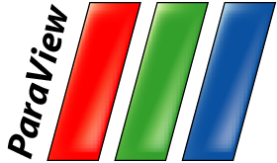



Large Scale Visualization with ParaView
Supercomputing 2013 Tutorial
November 17, 2013
Kenneth Moreland W. Alan Scott
Sandia National Laboratories
David DeMarle
Kitware, Inc.
Li-Ta Lo
Los Alamos National Laboratory
Sandia National Laboratories is a multi-program laboratory managed and operated by Sandia Corporation, a wholly owned subsidiary of Lockheed Martin Corporation, for the U.S. Department of Energy’s National Nuclear Security Administration under contract DE-AC04-94AL85000.
SAND 2013-9368P

Slide 2
Outline
Introduction
Basic Usage
Visualizing Large Models
Scripting

Slide 3
Outline
Introduction
Basic Usage
Visualizing Large Models
There is also “In Situ Visualization with Catalyst” tutorial this afternoon.
  Scripting, customization, integration with other codes.

Slide 4
Outline
Introduction
Basic Usage
Visualizing Large Models

Slide 5
To Follow Along…
Install ParaView 4.1.
  http://www.paraview.org → Download
Get example material.
  http://www.paraview.org/Wiki/The_ParaView_Tutorial
Data also available on thumb drives.
  Please don’t steal the thumb drives.
  They are personal property volunteered by presenters.
  They have never touched a Sandia computer.

Slide 6
Introduction

Slide 7
What is ParaView?
An open-source, scalable, multi-platform visualization application.
Support for distributed computation models to process large data sets.
An open, flexible, and intuitive user interface.
An extensible, modular architecture based on open standards.
A flexible BSD 3 Clause license
Commercial maintenance and support.

Slide 8
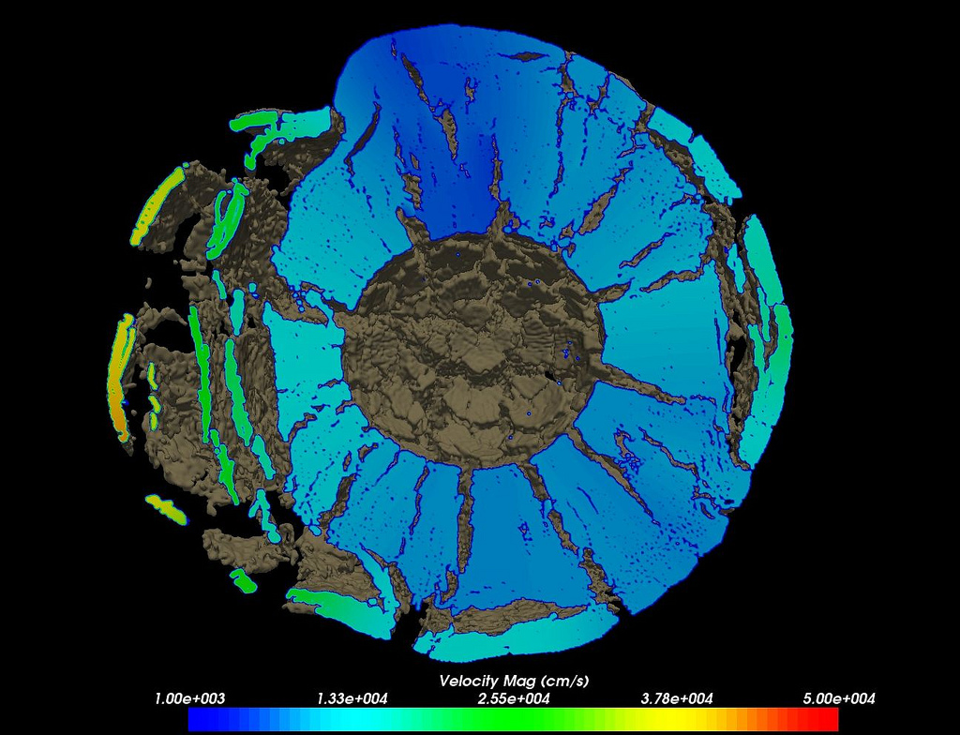
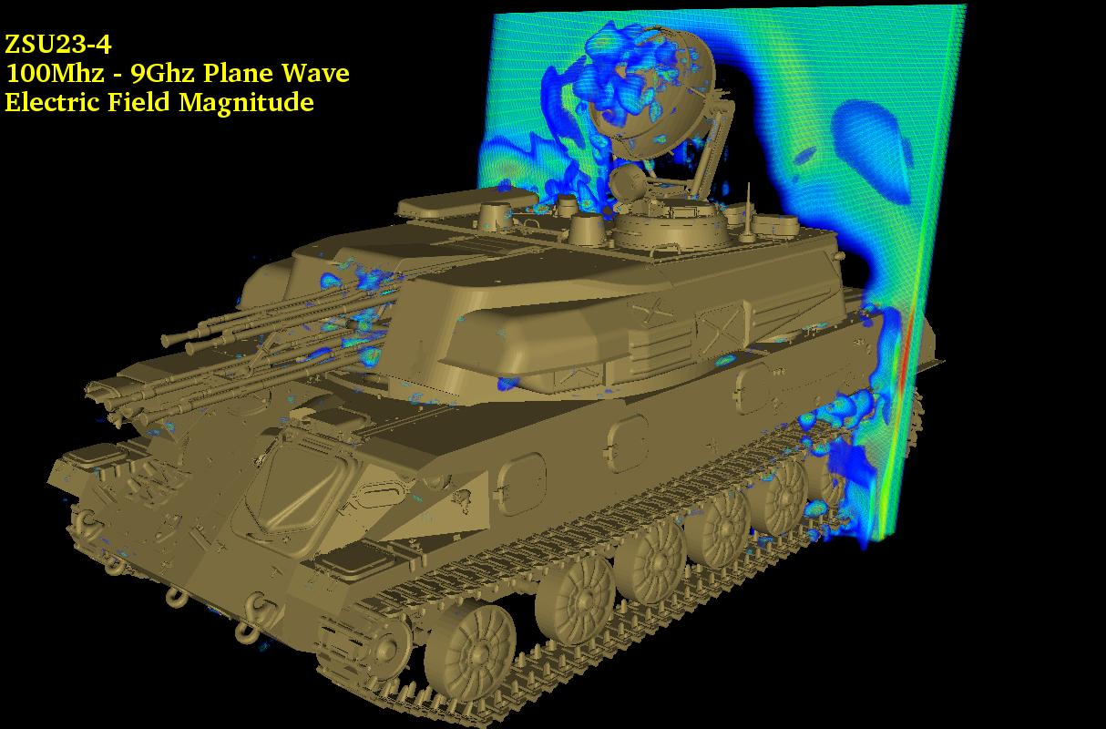
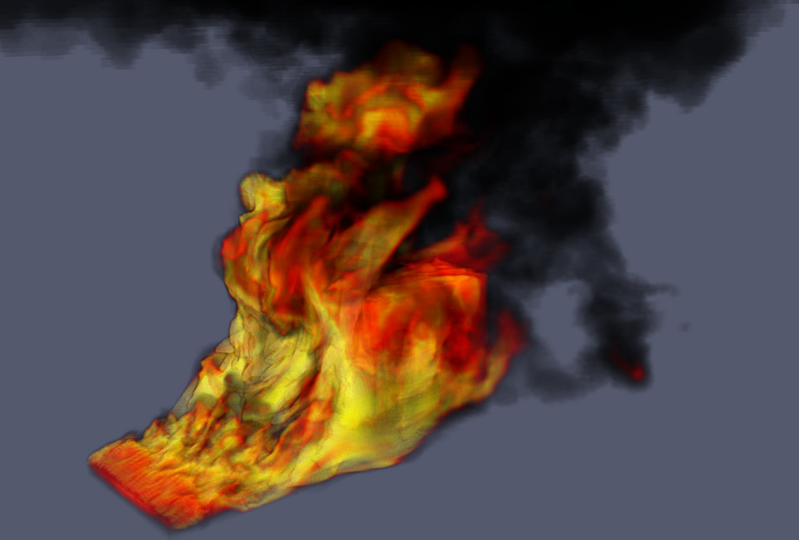
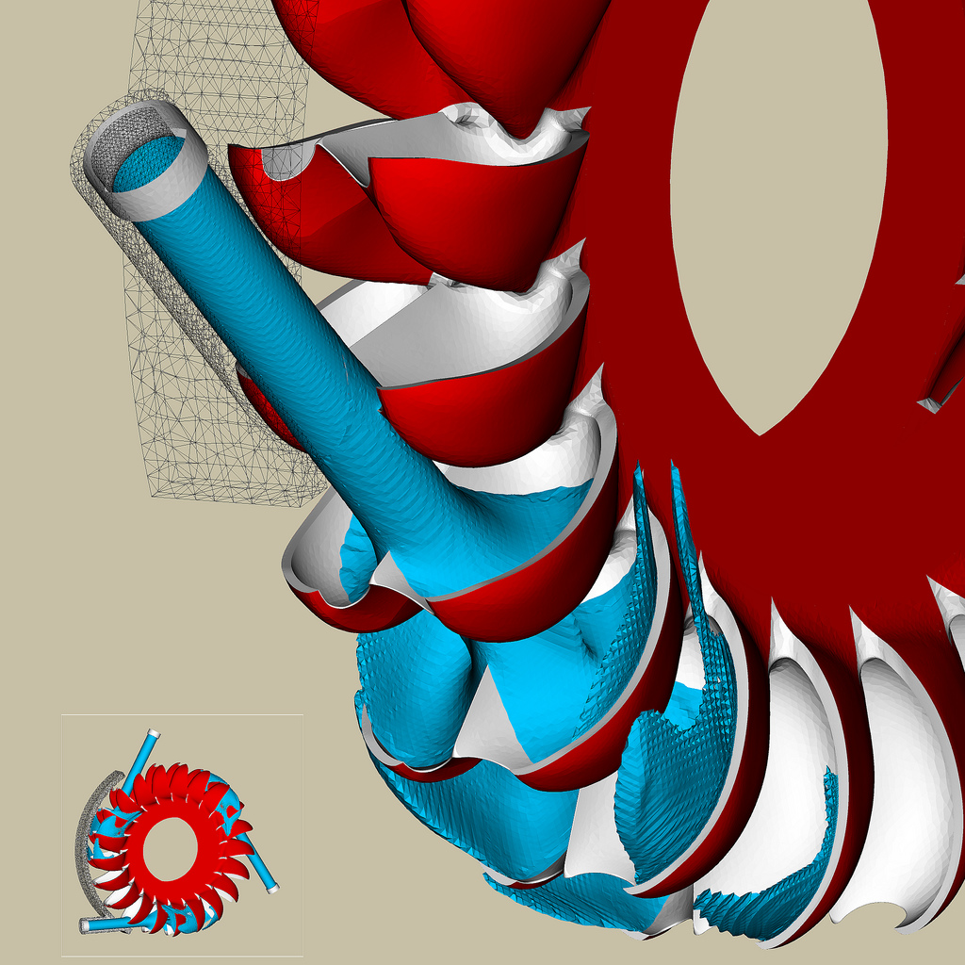
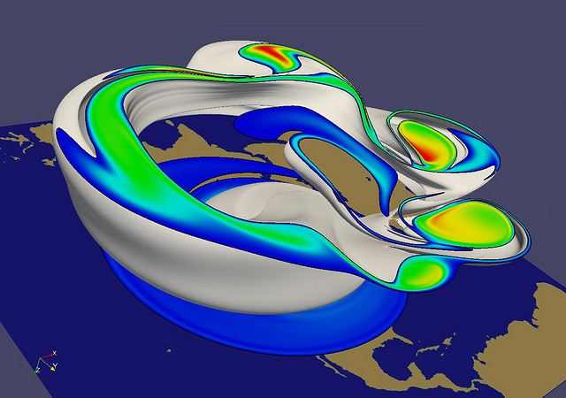
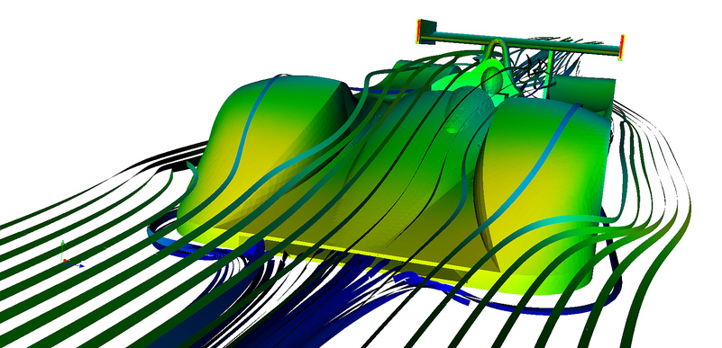
Jerry Clarke, US Army Research Laboratory
Swiss National Supercomputing Centre
Renato N. Elias, NACAD/COPPE/UFRJ, Rio de Janerio, Brazil
Notes:
Small montage of projects using ParaView.
Demonstrates the breadth of utility ParaView has.

Slide 9



Current ParaView Usage
Used by academic, government, and commercial institutions worldwide.
Downloaded ~100K times per year.
HPCwire Editors’ Choice 2010 and HPCwire Readers’ Choice 2010/2012 Awards for Best Visualization Product or Technology.

Slide 10
Data Ranges
Used for all ranges of data size.
Landmarks of SNL usage:
  6 billion structured cells (2005).
  250 million unstructured cells (2005).
  Billions of AMR cells (2008).
  Scaling test over 1 Trillion cells (2010).

Slide 11
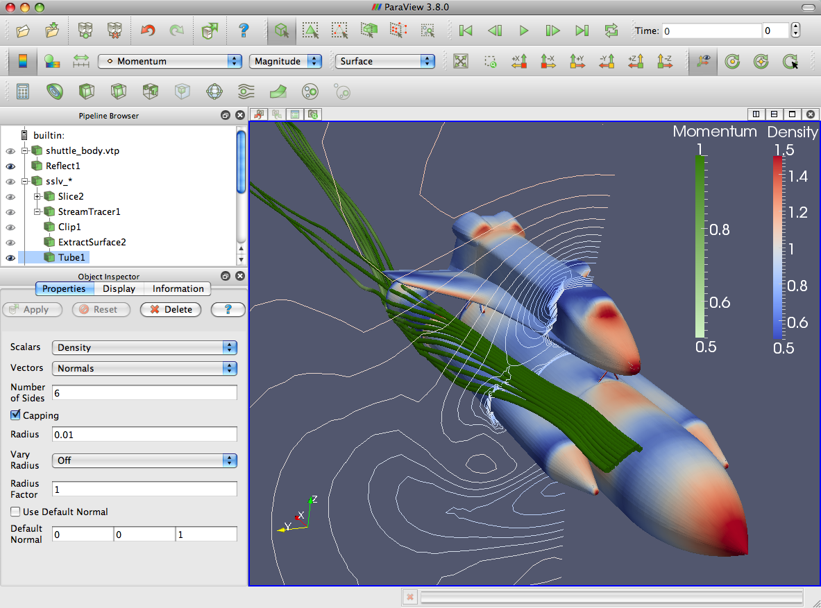
ParaView Application Architecture
ParaView Client
pvpython
ParaWeb
Catalyst
Custom App
UI (Qt Widgets, Python Wrappings)
ParaView Server
VTK
OpenGL
MPI
IceT
Etc.

Slide 12
ParaView Development
Started in 2000 as collaborative effort between Los Alamos National Laboratories and Kitware Inc. (lead by James Ahrens).
  ParaView 0.6 released October 2002.
September 2005: collaborative effort between Sandia National Laboratories, Kitware Inc. and CSimSoft to rewrite user interface to be more user friendly and develop quantitative analysis framework.
  ParaView 3.0 released in May 2007.
ParaView 4.0 released in June 2013.

Slide 13




Current Funding
ARL
ERDC
US Army (SBIR)
US Air Force (STTR)
ONR
Support Contracts
  Electricity de France
  Microsoft
Other contributors
  Swiss National Supercomputing Centre
  DOE SLAC
  Ohio State
  Mississippi State
  RPI

Slide 14
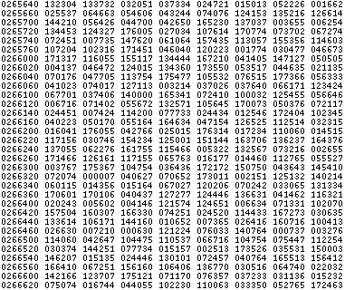
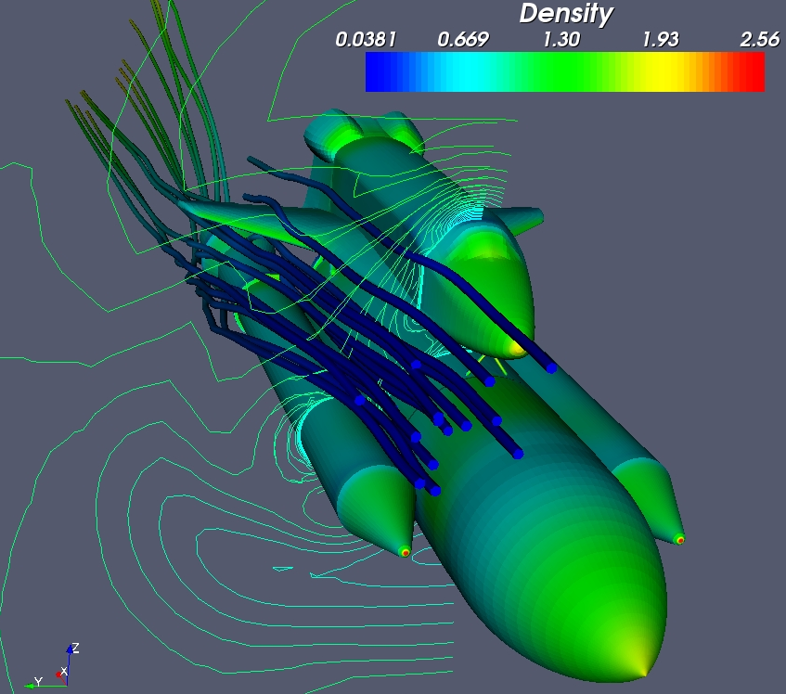
Basics of Visualization

Slide 15
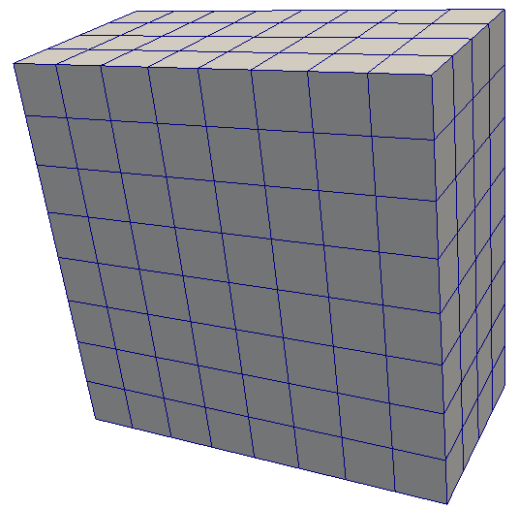
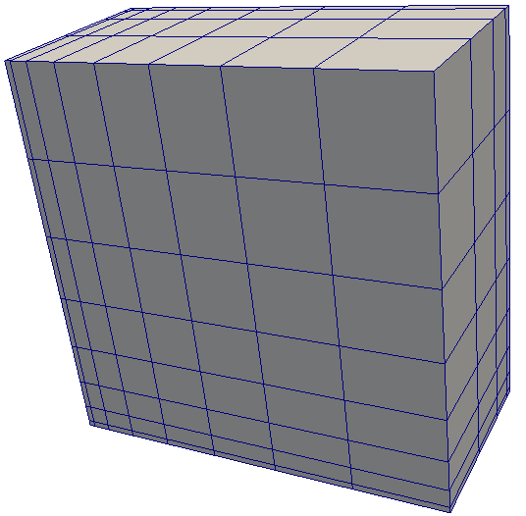
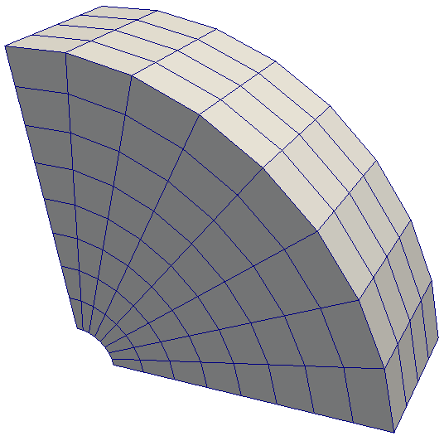
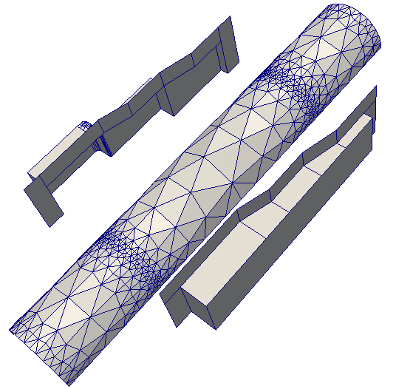
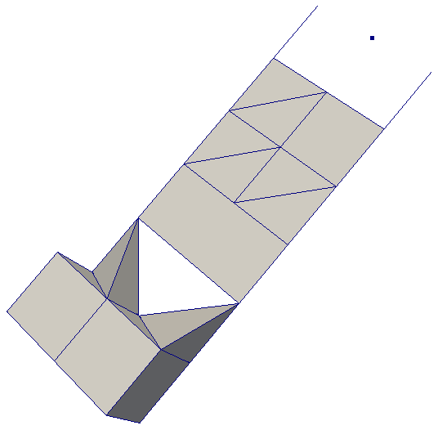
Data Types
Uniform Rectilinear
(vtkImageData)
Non-Uniform Rectilinear
(vtkRectilinearData)
Curvilinear
(vtkStructuredData)
Multi-block
Hierarchical Adaptive Mesh Refinement (AMR)
Hierarchical Uniform AMR
Octree
Polygonal
(vtkPolyData)
Unstructured Grid
(vtkUnstructuredGrid)

Slide 16

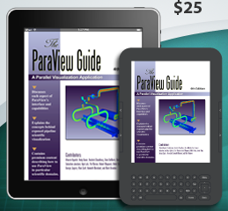
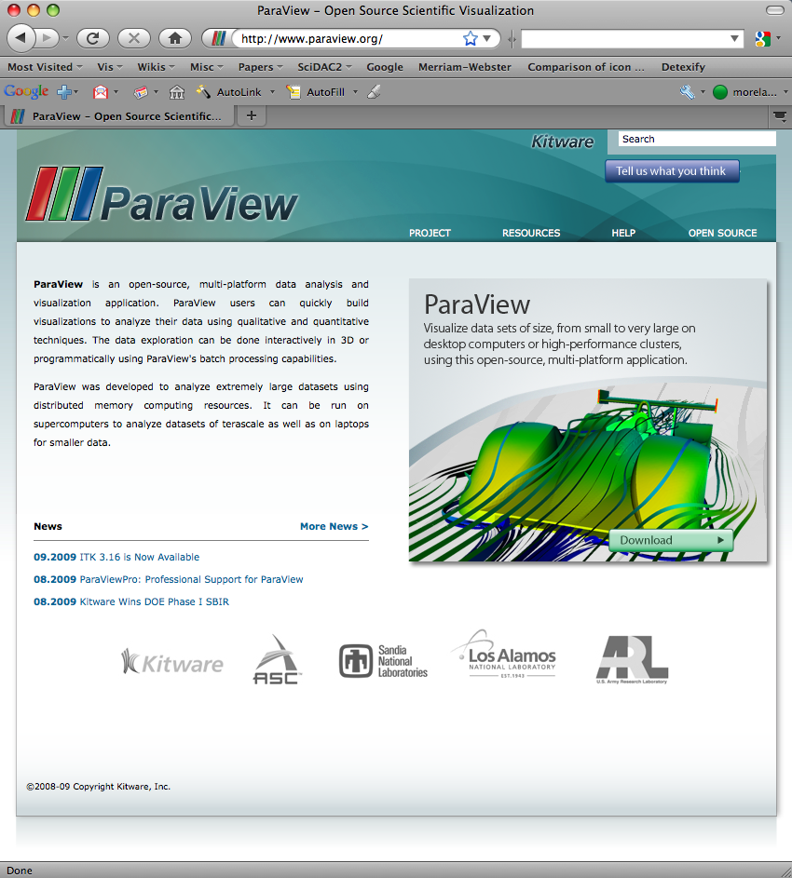
More Information
Online Help – F1
The ParaView User’s Guide
  http://paraview.org/Wiki/ParaView/Users_Guide/Table_Of_Contents
The ParaView web page
  www.paraview.org
ParaView mailing list
  paraview@paraview.org

Slide 17
Basic Usage

Slide 18
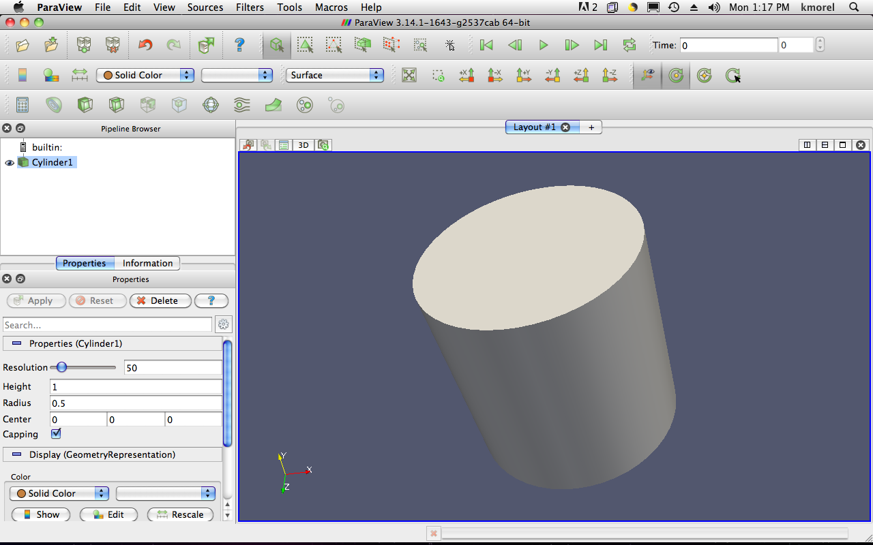
User Interface
Menu Bar
Toolbars
Pipeline Browser
Properties Panel
Advanced Toggle
3D View

Slide 19
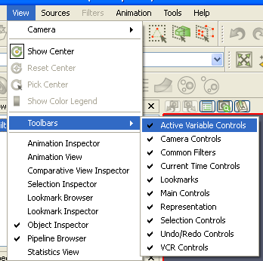
Getting Back GUI Components

Slide 20
Creating a Cylinder Source
Go to the Source menu and select Cylinder.
Click the Apply button to accept the default parameters.

Slide 21


Simple Camera Manipulation
Drag left, middle, right buttons for rotate, pan, zoom.
  Also use Shift, Ctrl, Alt modifiers.

Slide 22
Creating a Cylinder Source
Go to the Source menu and select Cylinder.
Click the Apply button to accept the default parameters.
Increase the Resolution parameter.
Click the button again.

Slide 23
Pipeline Object Controls

Slide 24




Undo Redo
Undo
Redo
Camera
Undo
Camera
Redo

Slide 25
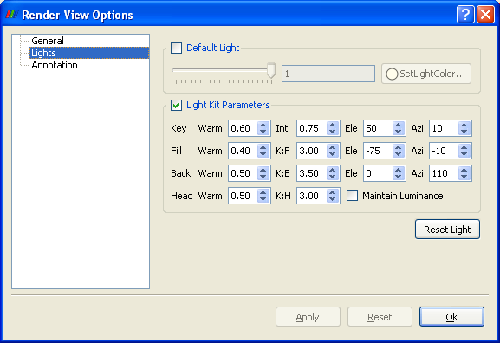

Render View Options

Slide 26
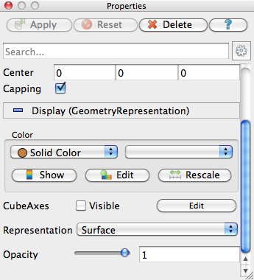
Display Properties

Slide 27
Creating a Cylinder Source
Go to the Source menu and select Cylinder.
Click the Apply button to accept the default parameters.
Increase the Resolution parameter.
Click the button again.
Delete the Cylinder.

Slide 28
Supported Data Types
ParaView Data (.pvd)
VTK (.vtp, .vtu, .vti, .vts, .vtr)
VTK Legacy (.vtk)
VTK Multi Block (.vtm,.vtmb,.vtmg,.vthd,.vthb)
Partitioned VTK (.pvtu, .pvti, .pvts, .pvtr)
ADAPT (.nc, .cdf, .elev, .ncd)
ANALYZE (.img, .hdr)
ANSYS (.inp)
AVS UCD (.inp)
BOV (.bov)
BYU (.g)
CAM NetCDF (.nc, .ncdf)
CCSM MTSD (.nc, .cdf, .elev, .ncd)
CCSM STSD (.nc, .cdf, .elev, .ncd)
CEAucd (.ucd, .inp)
CMAT (.cmat)
CML (.cml)
CTRL (.ctrl)
Chombo (.hdf5, .h5)
Claw (.claw)
Comma Separated Values (.csv)
Cosmology Files (.cosmo, .gadget2)
Curve2D (.curve, .ultra, .ult, .u)
DDCMD (.ddcmd)
Digital Elevation Map (.dem)
Dyna3D(.dyn)
EnSight (.case, .sos)
Enzo boundary and hierarchy
ExodusII (.g, .e, .exe, .ex2, .ex2v.., etc)
ExtrudedVol (.exvol)
FVCOM (MTMD, MTSD, Particle, STSD)
Facet Polygonal Data
Flash multiblock files
Fluent Case Files (.cas)
GGCM (.3df, .mer)
GTC (.h5)
GULP (.trg)
Gadget (.gadget)
Gaussian Cube File (.cube)
JPEG Image (.jpg, .jpeg)
LAMPPS Dump (.dump)
LAMPPS Structure Files
LODI (.nc, .cdf, .elev, .ncd)
LODI Particle (.nc, .cdf, .elev, .ncd)
LS-DYNA (.k, .lsdyna, .d3plot, d3plot)
M3DCl (.h5)
MFIX Unstructred Grid (.RES)
MM5 (.mm5)
MPAS NetCDF (.nc, .ncdf)
Meta Image (.mhd, .mha)
Miranda (.mir, .raw)
Multilevel 3d Plasma (.m3d, .h5)
NASTRAN (.nas, .f06)
Nek5000 Files
Nrrd Raw Image (.nrrd, .nhdr)
OpenFOAM Files (.foam)
PATRAN (.neu)
PFLOTRAN (.h5)
PLOT2D (.p2d)
PLOT3D (.xyz, .q, .x, .vp3d)
PLY Polygonal File Format
PNG Image Files
POP Ocean Files
ParaDIS Files
Phasta Files (.pht)
Pixie Files (.h5)
ProSTAR (.cel, .vrt)
Protein Data Bank (.pdb, .ent, .pdb)
Raw Image Files
Raw NRRD image files (.nrrd)
SAMRAI (.samrai)
SAR (.SAR, .sar)
SAS (.sasgeom, .sas, .sasdata)
SESAME Tables
SLAC netCDF mesh and mode data
SLAC netCDF particle data
Silo (.silo, .pdb)
Spheral (.spheral, .sv)
SpyPlot CTH
SpyPlot (.case)
SpyPlot History (.hscth)
Stereo Lithography (.stl)
TFT Files
TIFF Image Files
TSurf Files
Tecplot ASCII (.tec, .tp)
Tecplot Binary (.plt)
Tetrad (.hdf5, .h5)
UNIC (.h5)
VASP CHGCA (.CHG)
VASP OUT (.OUT)
VASP POSTCAR (.POS)
VPIC (.vpc)
VRML (.wrl)
Velodyne (.vld, .rst)
VizSchema (.h5, .vsh5)
Wavefront Polygonal Data (.obj)
WindBlade (.wind)
XDMF and hdf5 (.xmf, .xdmf)
XMol Molecule

Slide 29
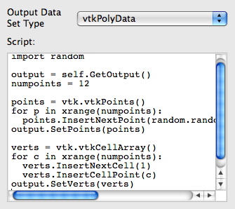
Custom Data Import:
Prototype with Python
A “programmable source” lets you program data readers right in the GUI.
Uses wrappings for the basic VTK classes.
Good for prototyping readers.

Slide 30
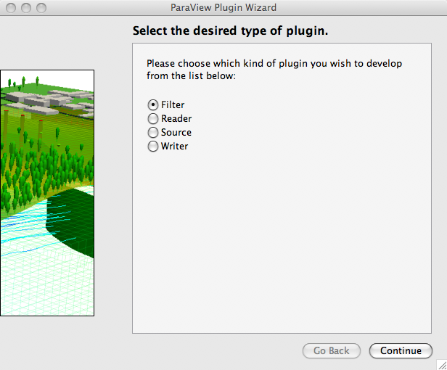
Custom Data Import:
Plugin Containing a Reader
Plugins: shared object libraries that can be dynamically loaded into ParaView.
Any VTK reader object can be added.
For help, try MIRARCO’s Plugin Wizard.
  http://pluginwizard.mirarco.org/

Slide 31
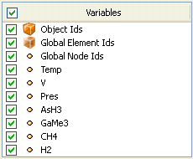
Load disk_out_ref.ex2
Open the file disk_out_ref.ex2.
Load all data variables.
Click

Slide 32
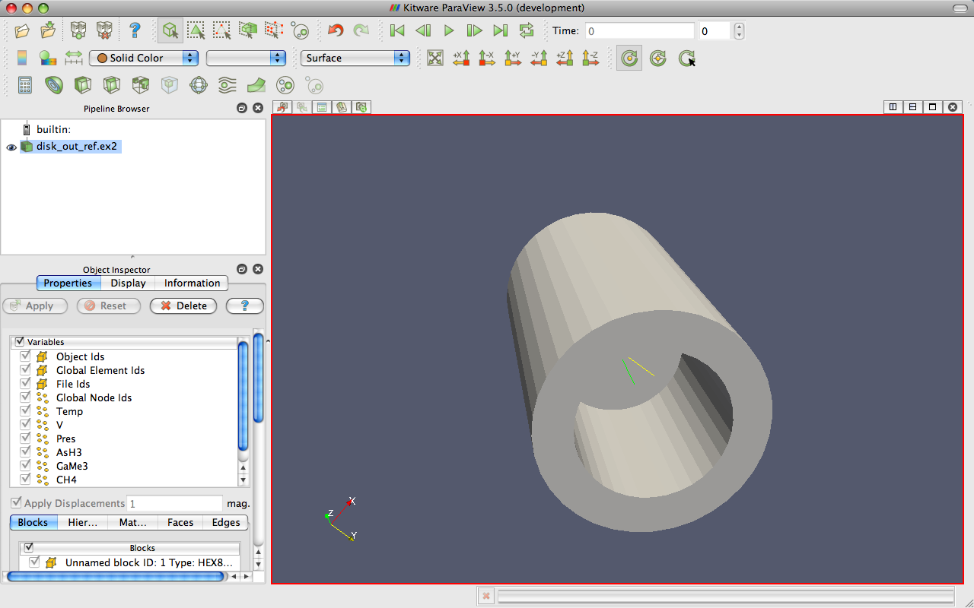
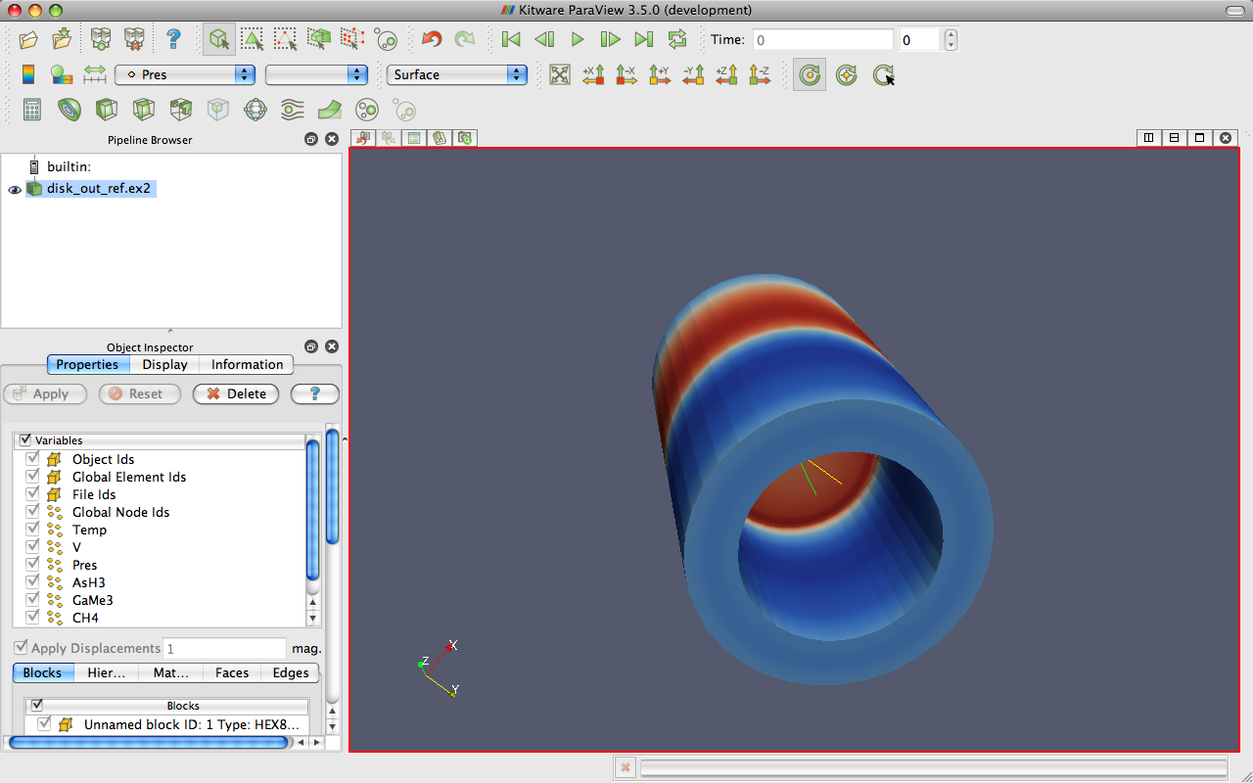
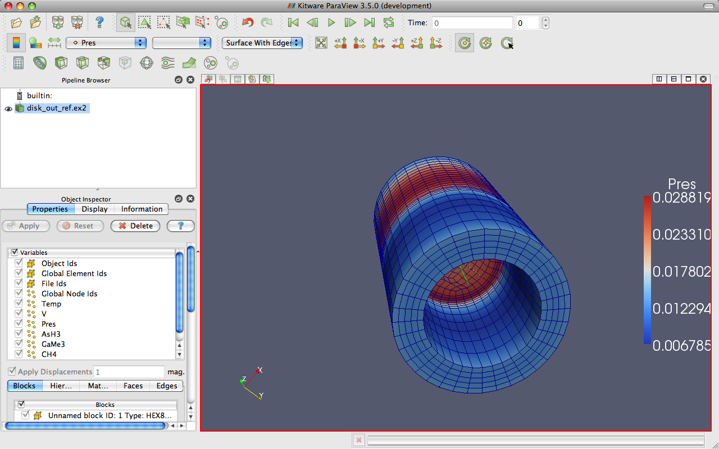
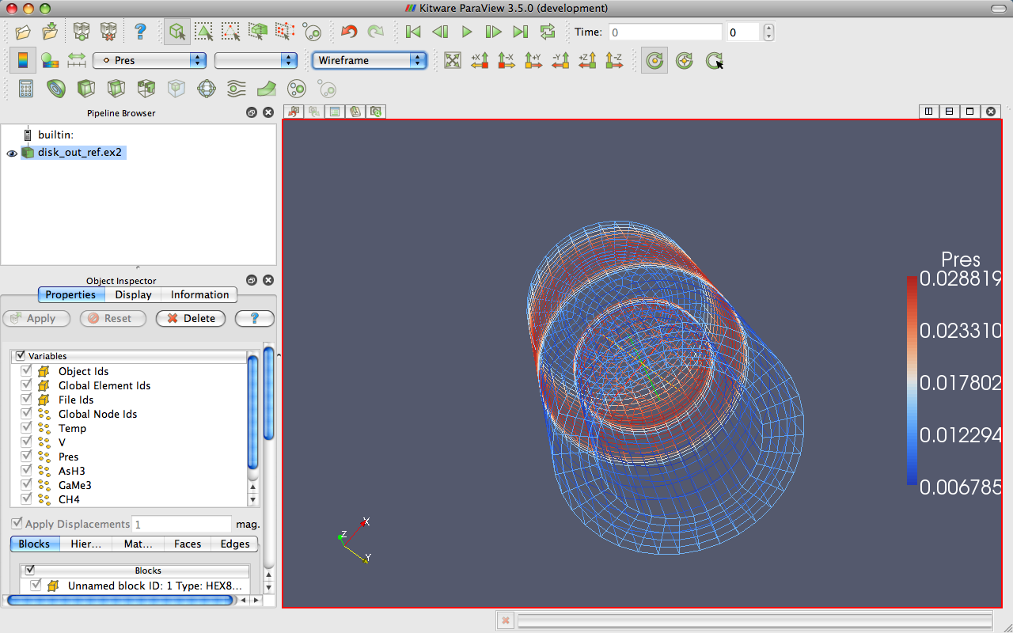
Data Representation
Toggle Color
Legend
Reset Scalar
Range
Mapped
Variable
Vector
Component
Representation
Edit Colors
Notes:
Also do volume rendering.

Slide 33
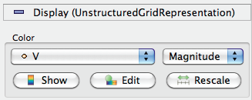
Data Representation
Mapped
Variable
Vector
Component
Toggle Color
Legend
Edit
Colors
Reset Scalar
Range
Representation
Notes:
Also do volume rendering.

Slide 34
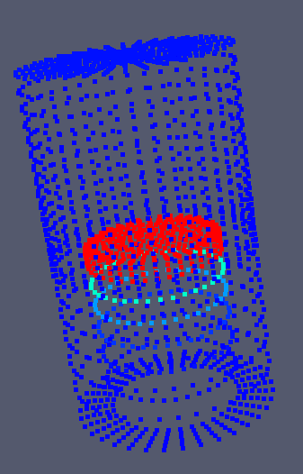
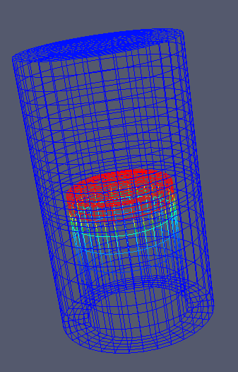
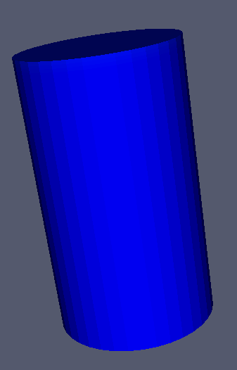
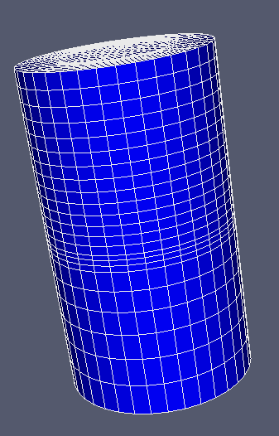
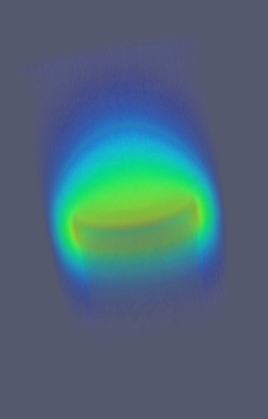
Geometry Representations
Points
Wireframe
Surface
Surface
with Edges
Volume

Slide 35











Common Filters
Calculator
Contour
Clip
Slice
Threshold
Extract Subset
Glyph
Stream Tracer
Warp (vector)
Group Datasets
Extract Level

Slide 36
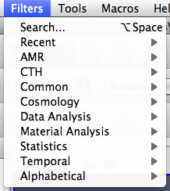
Filters Menu

Slide 37
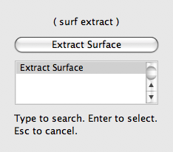
Quick Launch
Used for searching for filters by name
Keyboard shortcut
  Ctrl-space for Windows & Linux
  Alt-space for Mac
Notes:
ctrl-space: Win/Linux. alt-space: Mac

Slide 38
Apply a Filter
Make sure that disk_out_ref.ex2 is selected in the pipeline browser.
Select the contour filter.

Slide 39
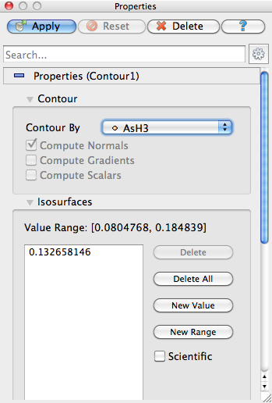
Apply a Filter
Change parameters to create an isosurface at Temp = 400K.
Change to Temp
Change to 400

Slide 40
Apply a Filter
Make sure that disk_out_ref.ex2 is selected in the pipeline browser.
Select the contour filter.
Change parameters to create an isosurface at Temp = 400K.

Slide 41
Create a Cutaway Surface
Select disk_out_ref.ex2 in the pipeline browser.
From the quick launch, select Extract Surface.

Slide 42
Create a Cutaway Surface
Select disk_out_ref.ex2 in the pipeline browser.
From the quick launch, select Extract Surface.
Create a clip filter.
Uncheck Show Plane.

Slide 43
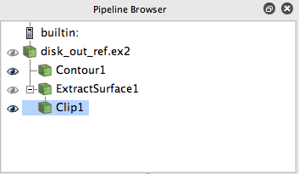
Pipeline Browser Structure
Disk_out_ref.ex2
DataSetSurfaceFilter1
Contour1
Clip1
Notes:
Mention eyeballs

Slide 44

Reset ParaView

Slide 45

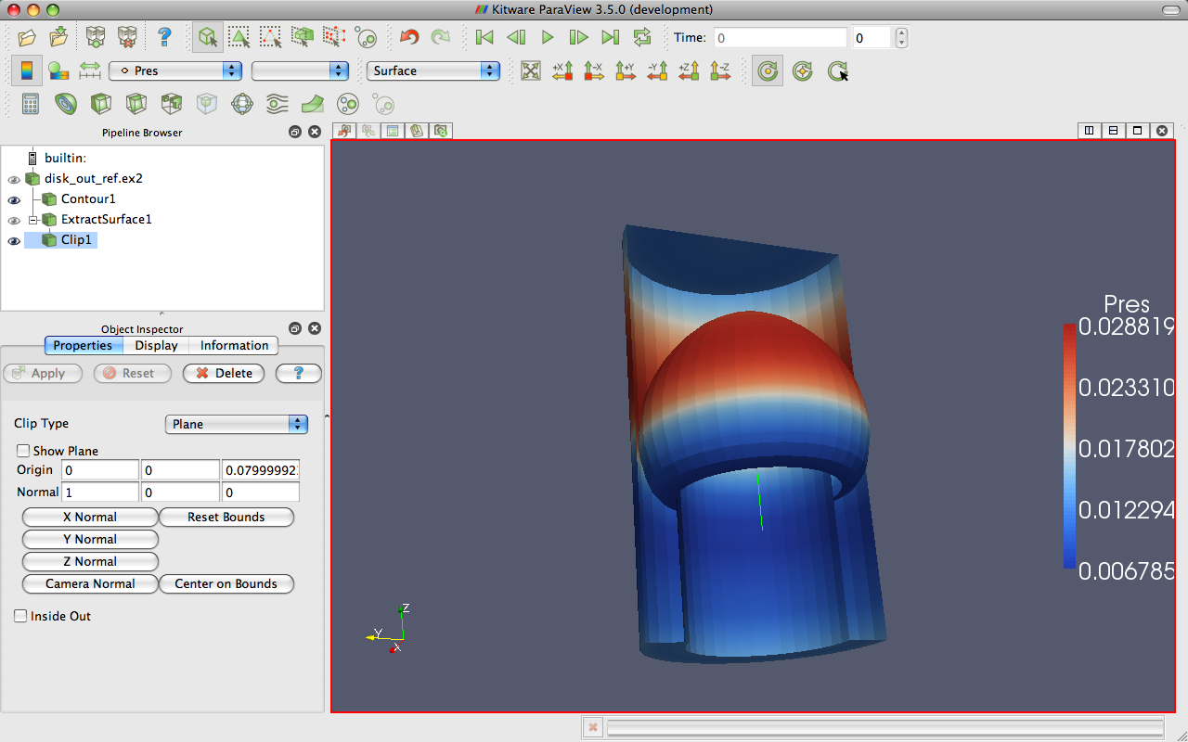
Multiview

Slide 46
Multiview
Open disk_out_ref.ex2. Load all variables.
Add clip filter.
Uncheck Show Plane.
Color surface by Pres.

Slide 47
Multiview
Split the view horizontally.
Make Clip1 visible.
Color surface by Temp.
Notes:
Problem: camera position different in each view.

Slide 48
Multiview
Split the view horizontally.
Make Clip1 visible.
Color surface by Temp.
Right-click view background, Link Camera…
Click other view.

Slide 49

Multiview
Split the view horizontally.
Make Clip1 visible.
Color surface by Temp.
Right-click view background, Link Camera…
Click other view.
Click

Slide 50
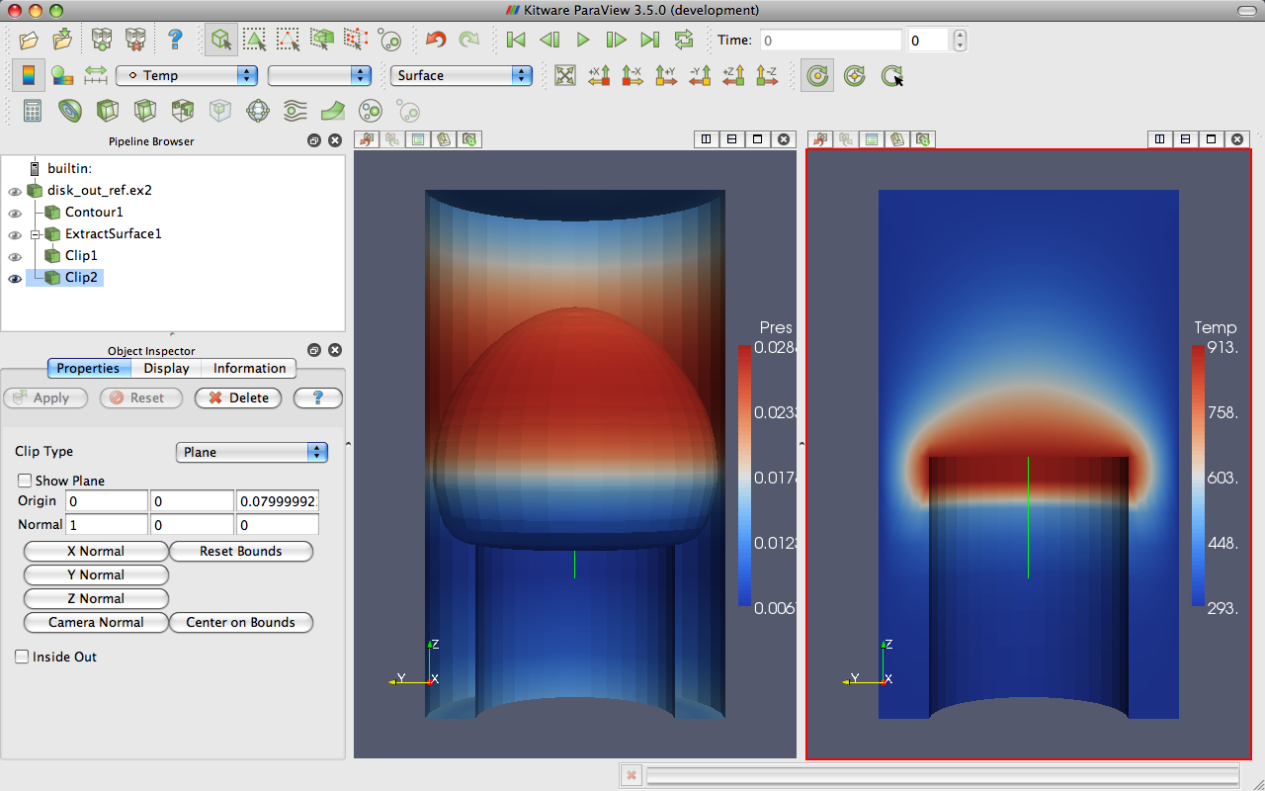
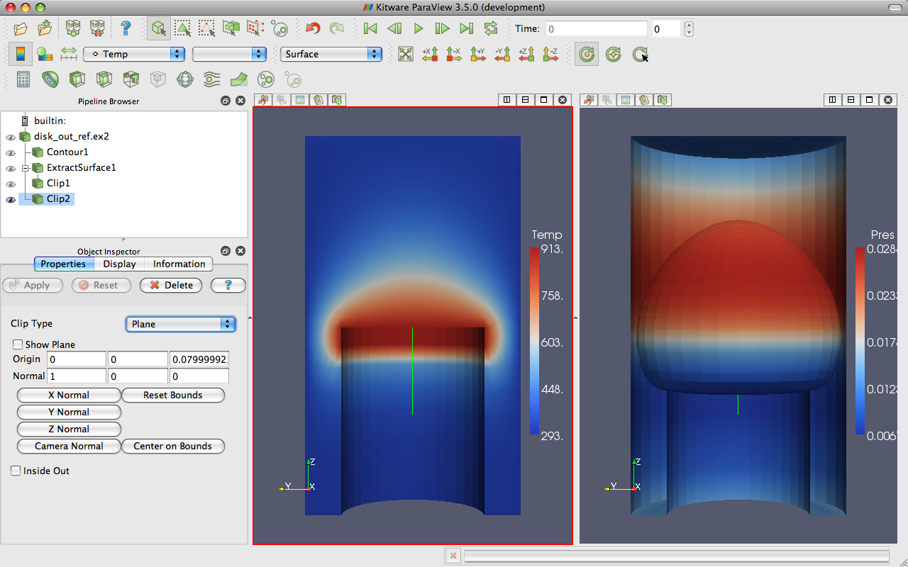
Modifying Views

Slide 51
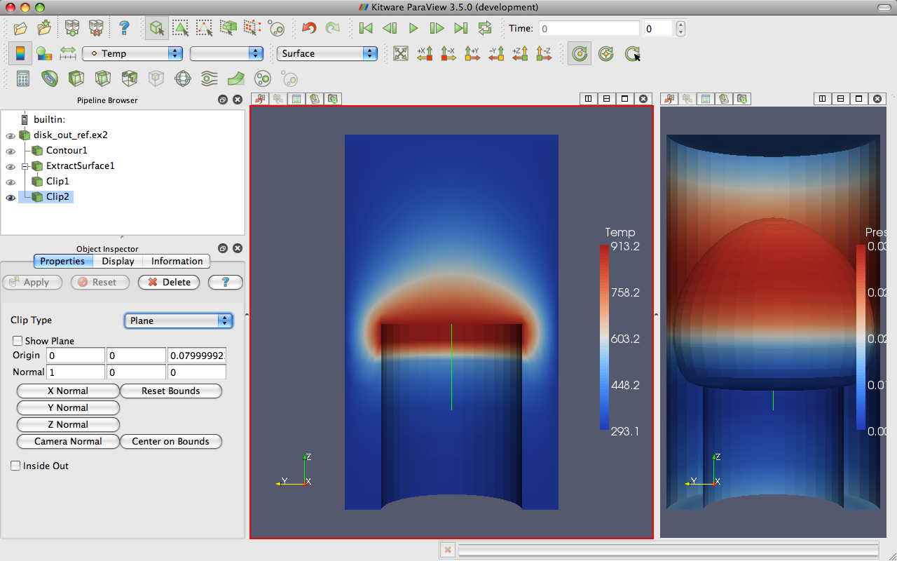
Modifying Views

Slide 52
Reset ParaView

Slide 53
Streamlines
Open disk_out_ref.ex2. Load all variables.
Add stream tracer.

Slide 54
Streamlines
Open disk_out_ref.ex2. Load all variables.
Add stream tracer.
From the quick launch, select Tube

Slide 55
Getting Fancy
Select StreamTracer1.
Add glyph filter.
Change Vectors to V.
Change Glyph Type to Cone.

Slide 56
Getting Answers
Where is the air moving the fastest? Near the disk or away from it? At the center of the disk or near its edges?
Which way is the plate spinning?
At the surface of the disk, is air moving toward the center or away from it?

Slide 57
Reset ParaView

Slide 58

Common Data Analysis Filters
Extract Selection
Plot Global Variables Over Time
Plot Over Line
Plot Selection Over Time
Probe Location

Slide 59
Plotting
Open disk_out_ref.ex2. Load all variables.
Clip, uncheck, ,
Select disk_out_ref.ex2
Add Plot Over Line filter.

Slide 60
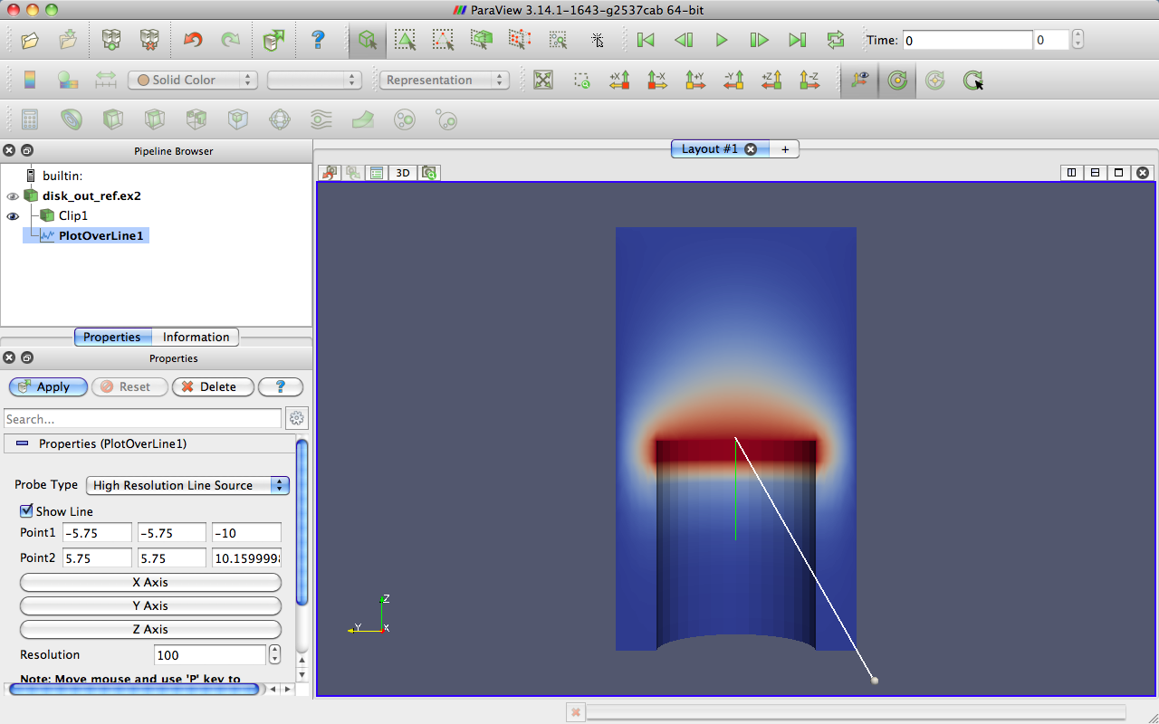
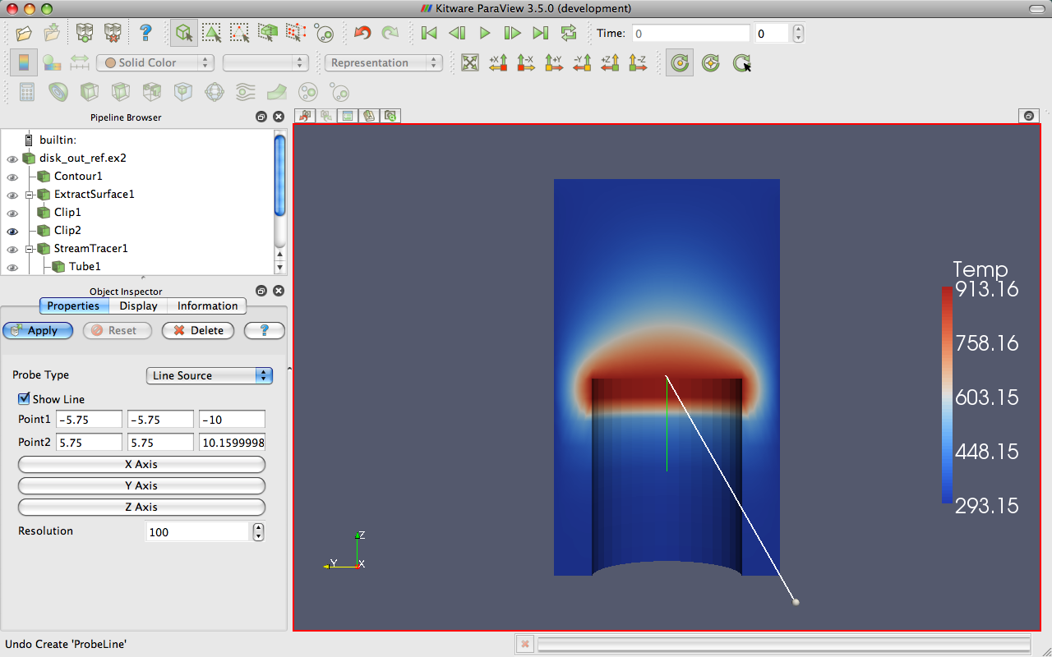
3D Widgets

Slide 61
Plotting
Open disk_out_ref.ex2. Load all variables.
Clip, uncheck, ,
Select disk_out_ref.ex2
Add Plot Over Line filter.
Once line is satisfactorily located,

Slide 62

Interacting with Plots
Left, middle, right buttons to pan, zoom.
Mouse wheel to zoom.
Reset view to plot ranges.

Slide 63
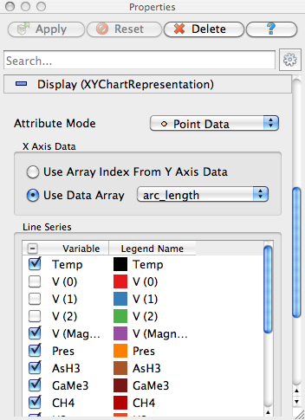
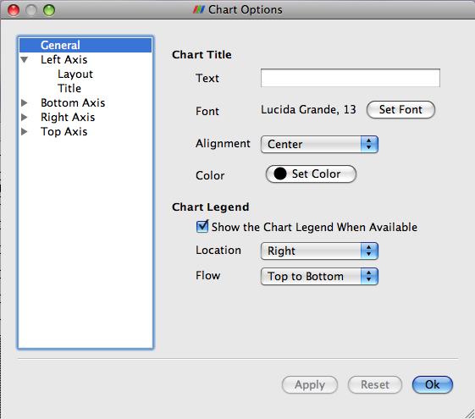
Plots are Views
Move them like Views.
Save screenshots.

Slide 64
Adjusting Plots
In Display tab, turn off all variables except Temp and Pres.
Select Pres in the Display tab.
Change Chart Axis to Bottom – Right.
Verify the relationship between temperature and pressure.
Notes:
From here, re-verify relationship of temperature and pressure.

Slide 65

Histogram / Bar Chart
Select disk_out_ref.ex2.
Filters → Data Analysis → Histogram
Change scalars to Temp.

Slide 66
Geometry Representations
Points
Wireframe
Surface
Surface
with Edges
Volume

Slide 67
Reset ParaView

Slide 68
Volume Rendering +
Surface Geometry
Open disk_out_ref.ex2. Load all variables.
Change variable viewed to Temp.
Change representation to Volume.

Slide 69
Volume Rendering +
Surface Geometry
Open disk_out_ref.ex2. Load all variables.
Change variable viewed to Temp.
Change representation to Volume.
Add stream tracer.
Optional: Add tubes and glyphs.

Slide 70
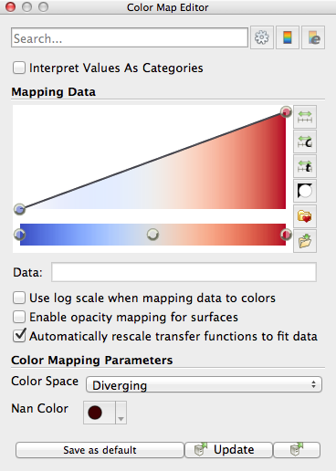

Transfer Function Editor
Notes:
Add control points by clicking in color box.
Drag control points to move them.
Delete active point by hitting backspace or delete.
Click active point to change its color.
Can save and load transfer functions.
Load black-body radiation.

Slide 71
Reset ParaView

Slide 72
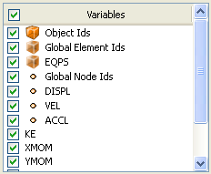


Loading Data with Time
Open the file can.ex2.
Select all variables.

Slide 73
Animation Toolbar
First
Frame
Previous
Frame
Next
Frame
Last
Frame
Loop
Animation
Current
Time
Current
Time Step
Play

Slide 74



Animation Pitfall
Go to first time step.
Color by EQPS variable.
Turn on color legend.
Play (or skip to last time step ).

Slide 75
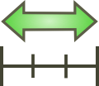
Animation Pitfall
Go to first time step.
Color by EQPS variable.
Turn on color legend.
Play (or skip to last time step ).
Fix with Rescale to Data Range.

Slide 76
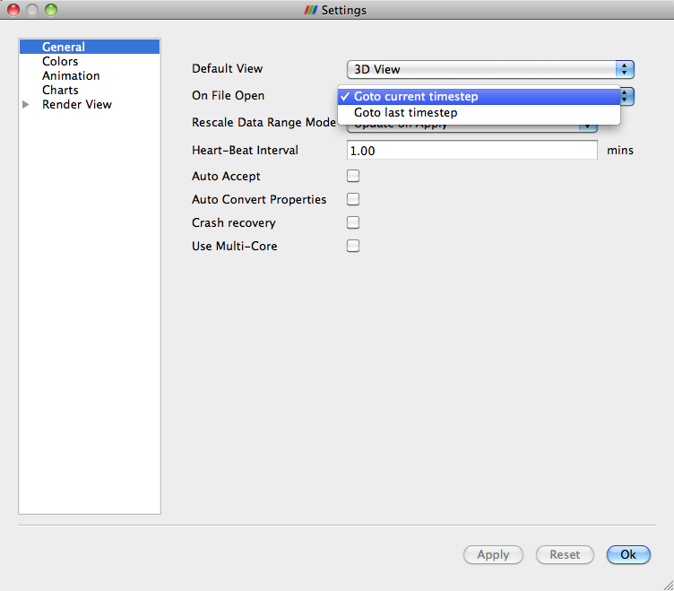
Data Range Workarounds
Go to representative time and hit
In Settings change On File Open to Goto last timestep.

Slide 77
Data Range Workarounds
Open color scale editor dialog
Set a custom range.

Slide 78
Data Range Workarounds
Open color scale editor dialog
Rescale to range over all timesteps

Slide 79
Save Screenshot/Animation
Choose File → Save Screenshot…
Complete the following dialogs to save an image.
Chose File → Save Animation…
Complete the following dialogs to save a movie.

Slide 80
Query-Based Selection
Open can.ex2. All variables.
Go to last time step.
Edit → Find Data.
Top combo box: find Cells.
Next row: EQPS, is >=, and 1.5.
Click Run Selection Query.

Slide 81

Query-Based Selection

Slide 82




Brush Selection
Surface Cell Selection (shortcut: s)
Surface Point Selection
Through Cell Selection
Through Point Selection
Select Points (polygon)
Select Cells (polygon)
Block Selection (shortcut: b)
Notes:
Rubber band selection tools and polygon selection tools which create polygon by dragging

Slide 83
Selections
Open Find Data.
Make various brush selections.
Observe results in the Find Data dialog box.
Play with the Invert Selection and Show Frustum options.
Notes:
You may want to move the Selection Inspector

Slide 84
Frustum vs. Id Selections
Make a Select Cells Through
Turn on Show Frustum in Find Data. Rotate 3D view.
Play
Hit Freeze Selection in Find Data.
Play

Slide 85
Spreadsheet View
Split the view
In new view, click Spreadsheet View.

Slide 86

Spreadsheet View
What is
shown in
the view
Attribute shown
Show only selection items
Show cell points
Select items to show

Slide 87
Spreadsheet View
Split the view
In new view, click Spreadsheet View.
For Attribute, select Cell Data.
Find selected rows in spreadsheet.
Turn on Show only selected elements.
Notes:
Might need to select different block to find selected rows.

Slide 88
Selecting in Spreadsheet View
Uncheck Show only selected elements.
Select a few rows in the spreadsheet.
Find selection in 3D view.
Click Cell Label tab in Selection Inspector.
Check Visible.
Change Label Mode to EQPS.

Slide 89
Adding Labels
Select a few cells (not too many).
Open Find Data.
In the Labels chooser, select EQPS.

Slide 90
Plot Selection Over Time
Select a single cell where something “interesting” happens.
From the quick launch, select Plot Selection Over Time
In Display panel, select different blocks to plot.

Slide 91
Reset ParaView

Slide 92

Extracting a Selection
Open can.ex2. Load all variables.
Perform a sizeable selection.
Add the extract selection filter.

Slide 93
Reset ParaView
And close the selection inspector.

Slide 94

Animation View
View → Animation View

Slide 95
Animation View
View → Animation View
Animation Modes: Sequence, Real Time, and Snap To TimeSteps

Slide 96
Changing Animation Timing
Open can.ex2. Load all variables.
Change animation mode to Real Time.
  Default animation time is 10 sec.

Slide 97
Changing Animation Timing
Open can.ex2. Load all variables.
Change animation mode to Real Time.
  Default animation time is 10 sec.
Change animation time to 60 sec.
again.

Slide 98
Smoothing the Animation
From the quick launch, select Temporal Interpolator.
Change mode back to Real Time.
Split view. Show can.ex2 in one and TemporalInterpolator1 in the other. Link the cameras.

Slide 99
Adding Text Annotation
If you have fell behind, you can reset ParaView and reload can.ex2.
Sources → Text
Type a message in text edit box

Slide 100

Text Position
Notes:
You can move text around with the mouse or pick a standard window location.

Slide 101
Annotate Time
Sources → Annotate Time

Slide 102
Annotate Time
Sources → Annotate Time
Select can.ex2
From quick dialog, select Annotate Time Filter
Move annotation around.

Slide 103
Reset ParaView

Slide 104
Make an Animation
Sources → Sphere,
Make animation view visible.
Change No. Frames to 50.
Select Sphere1, Start Theta, press

Slide 105
Make an Animation
Sources → Sphere,
Make animation view visible.
Change No. Frames to 50.
Select Sphere1, Start Theta, press
Double-click Sphere1 – Start Theta
Make New keyframe.
First keyframe value→360, second keyframe time→0.5 value→0.
Click OK.

Slide 106
Animating Two Properties
Open Sphere1 – Start Theta.
Delete the first keyframe (at time 0).
Click OK.
Create Sphere1 – End Theta.
Open Sphere1 – End Theta.
Change second key frame time to 0.5.

Slide 107
Python Trace Demo

Slide 108
Visualizing Large Models

Slide 109

Golevka Asteroid vs.
10 Megaton Explosion
CTH shock physics, over 1 billion cells

Slide 110

Polar Vortex Breakdown
SEAM Climate Modeling, 1 billion cells (500 million cells visualized).

Slide 111

Objects-in-Crosswind Fire
Coupled SIERRA/Fuego/Syrinx/Calore, 10 million unstructured hexahedra

Slide 112

Large Scale AMR
Notes:
Works on huge numbers of cells in an uncharacteristically large number of blocks
Working with data containing 10’s of thousands to 100’s of thousands of blocks and billions of cells.

Slide 113




Wing with Unsteady Crossflow from Synthetic Jet (3.3B tet)
Notes:
Simulation of flow over a full wing where a synthetic jet issues unsteady crossflow jet at 1750Hz.
3.3 billion tetrahedra
Run in situ with PHASTA simulation on 160 thousand cores.

Slide 114
ParaView Architecture
Three tier
  Data Server
  Render Server
  Client

Slide 115
Standalone
Client
Data
Server
Render
Server

Slide 116
Client-Server
Data
Server
Render
Server
Client

Slide 117
Client-Render Server-Data Server
Data
Server
Render
Server
Client

Slide 118
Requirements for
Installing ParaView Server
C++
CMake (www.cmake.org)
MPI
OpenGL (or Mesa3D www.mesa3d.org)
Qt 4.6 (optional)
Python (optional)
http://www.paraview.org/Wiki/Setting_up_a_ParaView_Server#Compiling

Slide 119


Connecting to a ParaView Server
http://www.paraview.org/Wiki/Setting_up_a_ParaView_Server#Running_the_Server

Slide 120
Data Parallel Pipelines
Duplicate pipelines run independently on different partitions of data.

Slide 121
Data Parallel Pipelines
Duplicate pipelines run independently on different partitions of data.

Slide 122
Data Parallel Pipelines
Some operations will work regardless.
  Example: Clipping.

Slide 123
Data Parallel Pipelines
Some operations will work regardless.
  Example: Clipping.

Slide 124
Data Parallel Pipelines
Some operations will work regardless.
  Example: Clipping.

Slide 125
Data Parallel Pipelines
Some operations will have problems.
  Example: External Faces

Slide 126
Data Parallel Pipelines
Some operations will have problems.
  Example: External Faces

Slide 127
Data Parallel Pipelines
Ghost cells can solve most of these problems.

Slide 128
Data Parallel Pipelines
Ghost cells can solve most of these problems.

Slide 129
Data Partitioning
Partitions should be load balanced and spatially coherent.

Slide 130
Data Partitioning
Partitions should be load balanced and spatially coherent.

Slide 131
Data Partitioning
Partitions should be load balanced and spatially coherent.

Slide 132


Load Balancing/Ghost Cells
Automatic for Structured Meshes.
Partitioning/ghost cells for unstructured is “manual.”
Use the D3 filter for unstructured
  (Filters → Alphabetical → D3)

Slide 133
Job Size Rules of Thumb
Structured Data
  Try for max 20 M cell/processor.
  Shoot for 5 – 10 M cell/processor.
Unstructured Data
  Try for max 1 M cell/processor.
  Shoot for 250 – 500 K cell/processor.

Slide 134
Avoiding Data Explosion
Pipeline may cause data to be copied, created, converted.
This advice only for dealing with very large amounts of data.
  Remaining available memory is low.

Slide 135
Topology Changing, No Reduction
Append Datasets
Append Geometry
Clean
Clean to Grid
Connectivity
D3
Delaunay 2D/3D
Extract Edges
Linear Extrusion
Loop Subdivision
Reflect
Rotational Extrusion
Shrink
Smooth
Subdivide
Tessellate
Tetrahedralize
Triangle Strips
Triangulate
Notes:
Ribbon and Tube
Use with caution on unstructured data
Never use with structured data

Slide 136
Topology Changing,
Moderate Reduction
Clip
Decimate
Extract Cells by Region
Extract Selection
Quadric Clustering
Threshold
Similar: Extract Subset
Notes:
Use with caution on unstructured data.
Use with extreme caution on structured data.

Slide 137
Topology Changing,
Dimension Reduction
Cell Centers
Contour
Extract CTH Fragments
Extract CTH Parts
Extract Surface
Feature Edges
Mask Points
Outline (curvilinear)
Slice
Stream Tracer
Notes:
Usually safe with unstructured data.
Requires only mild caution with structured data.

Slide 138
Adds Field Data
Block Scalars
Calculator
Cell Data to Point Data
Compute Derivatives
Curvature
Elevation
Generate Ids
Gen. Surface Normals
Gradient
Level Scalars
Median
Mesh Quality
Octree Depth Limit
Octree Depth Scalars
Point Data to Cell Data
Process Id Scalars
Random Vectors
Resample with dataset
Surface Flow
Surface Vectors
Texture Map to…
Transform
Warp (scalar)
Warp (vector)
Notes:
Usually safe on all data.

Slide 139

Total Shallow Copy or
Output Independent of Input
Annotate Time
Append Attributes
Extract Block
Extract Datasets
Extract Level
Glyph
Group Datasets
Histogram
Integrate Variables
Normal Glyphs
Outline
Outline Corners
Plot Global Variables Over Time
Plot Over Line
Plot Selection Over Time
Probe Location
Temporal Shift Scale
Temporal Snap-to-Time-Steps
Temporal Statistics

Slide 140

Special Cases
Temporal Filters
  Temporal Interpolator
  Particle Tracer
  Temporal Cache
Programmable Filter

Slide 141
Culling Data
Reduce dimensionality early.
  Contour and slice “see” inside volumes.
Prefer data reduction over extraction.
  Slice instead of Clip.
  Contour instead of Threshold.
Only extract when reducing an order of magnitude or more.
  Can still run into troubles.

Slide 142
Culling Data
Experiment with subsampled data.
  Extract Subset
Use caution.
  Subsampled data may be lacking.
  Use full data to draw final conclusions.

Slide 143

Memory Inspector

Slide 144
Rendering Modes
Still Render
  Full detail render.
Interactive Render
  Sacrifices detail for speed.
  Provides quick rendering rate.
  Used when interacting with 3D view.

Slide 145



Level of Detail (LOD)
Geometric decimation
Used only with Interactive Render
Original Data
Divisions: 50x50x50
Divisions: 10x10x10

Slide 146

3D Rendering Parameters
Edit → Settings, Render View → General

Slide 147





Parallel Rendering
Notes:
IceT
Sort-last -> image compositing
Insensitive to iamge data size

Slide 148




Parallel Rendering

Slide 149









Tiled Displays

Slide 150




Image Size LOD
ParaView’s parallel rendering overhead proportional to image size.
Can use smaller images for interactive rendering.
Original Data
Subsample Rate: 2 pixels
Subsample Rate: 4 pixels
Subsample Rate: 8 pixels

Slide 151

Parallel Rendering Parameters
Edit → Settings, Render View → Server

Slide 152
Parameters for Large Data
Use Immediate Mode Rendering off for GPU, on for CPU.
Try LOD Threshold off.
  Also try LOD Resolution 10x10x10.
Always have remote rendering on.
Turn on subsampling.
Image Compression on.

Slide 153
Parameters for Low Bandwidth
  Try larger subsampling rates.
Try Zlib compression and fewer bits.

Slide 154
Parameters for High Latency
Turn up Remote Render Threshold.
Turn on Use outline for LOD rendering if necessary.
Play with the LOD Threshold and LOD Resolution to control geometry sent to client.
Try turning on Lock Interactive Render.

Slide 155
Python Trace Demo

Slide 156
Plugin Demo

Slide 157

Thanks for Attending
Please Fill Out the Survey
http://bit.ly/sc13-tut-sh03

Slide 158
Further Reading
The ParaView User’s Guide
  http://paraview.org/Wiki/ParaView/Users_Guide/Table_Of_Contents
http://www.paraview.org/Wiki/ParaView
http://www.paraview.org/Wiki/Setting_up_a_ParaView_Server

Slide 159
Further Reading
Visualization and Customization
Will Schroeder, Ken Martin, and Bill Lorensen. The Visualization Toolkit. Kitware, Inc., fourth edition, 2006.
Kitware Inc. The VTK User’s Guide. Kitware, Inc., 2006.
Jasmin Blanchette and Mark Summerfield. C++ GUI Programming with Qt 4. Prentice Hall, 2006.

Slide 160
Further Reading
Parallel VTK Topics
James Ahrens, Charles Law, Will Schroeder, Ken Martin, and Michael Papka. “A Parallel Approach for Efficiently Visualizing Extremely Large, Time-Varying Datasets.” Technical Report #LAUR-00-1620, Los Alamos National Laboratory, 2000.
James Ahrens, Kristi Brislawn, Ken Martin, Berk Geveci, C. Charles Law, and Michael Papka. “Large-Scale Data Visualization Using Parallel Data Streaming.” IEEE Computer Graphics and Applications, 21(4): 34–41, July/August 2001.
Andy Cedilnik, Berk Geveci, Kenneth Moreland, James Ahrens, and Jean Farve. “Remote Large Data Visualization in the ParaView Framework.” Eurographics Parallel Graphics and Visualization 2006, pg. 163–170, May 2006.

Slide 161
Further Reading
Advanced Pipeline Execution
James P. Ahrens, Nehal Desai, Patrick S. McCormic, Ken Martin, and Jonathan Woodring. “A Modular, Extensible Visualization System Architecture for Culled, Prioritized Data Streaming.” Visualization and Data Analysis 2007, Proceedings of SPIE-IS&T Electronic Imaging, pg 64950I-1–12, January 2007.
John Biddiscombe, Berk Geveci, Ken Martin, Kenneth Moreland, and David Thompson. “Time Dependent Processing in a Parallel Pipeline Architecture.” IEEE Visualization 2007. October 2007.

Slide 162
Further Reading
Parallel Rendering
Kenneth Moreland, Brian Wylie, and Constantine Pavlakos. “Sort-Last Parallel Rendering for Viewing Extremely Large Data Sets on Tile Displays.” Proceedings of IEEE 2001 Symposium on Parallel and Large-Data Visualization and Graphics, pg. 85–92, October 2001.
Kenneth Moreland and David Thompson. “From Cluster to Wall with VTK.” Proceddings of IEEE 2003 Symposium on Parallel and Large-Data Visualization and Graphics, pg. 25–31, October 2003.
Kenneth Moreland, Lisa Avila, and Lee Ann Fisk. “Parallel Unstructured Volume Rendering in ParaView.” Visualization and Data Analysis 2007, Proceedings of SPIE-IS&T Electronic Imaging, pg. 64950F-1–12, January 2007.

