Slide 1

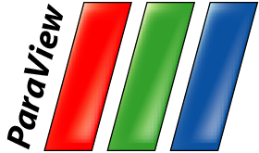



Large Scale Visualization with ParaView
Supercomputing 2014 Tutorial
November 16, 2014
Kenneth Moreland
W. Alan Scott
Sandia National Laboratories
Sebastien Jourdain
David DeMarle
Robert Maynard
Kitware, Inc.
La-Ta Lo
Los Alamos National Laboratory
Joseph Insley
Argonne National Laboratory
Sandia National Laboratories is a multi-program laboratory managed and operated by Sandia Corporation, a wholly owned subsidiary of Lockheed Martin Corporation, for the U.S. Department of Energy’s National Nuclear Security Administration under contract DE-AC04-94AL85000.
SAND 2014-17514 PE

Slide 2
Outline
Introduction
Basic Usage
Visualizing Large Models
Batch Scripting
ParaView Cinema
ParaViewWeb
ParaView – Catalyst Integration
  (Detailed Catalyst tutorial tomorrow morning.)

Slide 3
To Follow Along…
Install ParaView 4.2.
  http://www.paraview.org → Download
Get example material.
  http://www.paraview.org/Wiki/The_ParaView_Tutorial
Data also available on thumb drives.
  Please don’t steal the thumb drives.
  They are personal property volunteered by presenters.
  They have never touched a Sandia computer.

Slide 4
Introduction

Slide 5
What is ParaView?
An open-source, scalable, multi-platform visualization application.
Support for distributed computation models to process large data sets.
An open, flexible, and intuitive user interface.
An extensible, modular architecture based on open standards.
A flexible BSD 3 Clause license
Commercial maintenance and support.

Slide 6
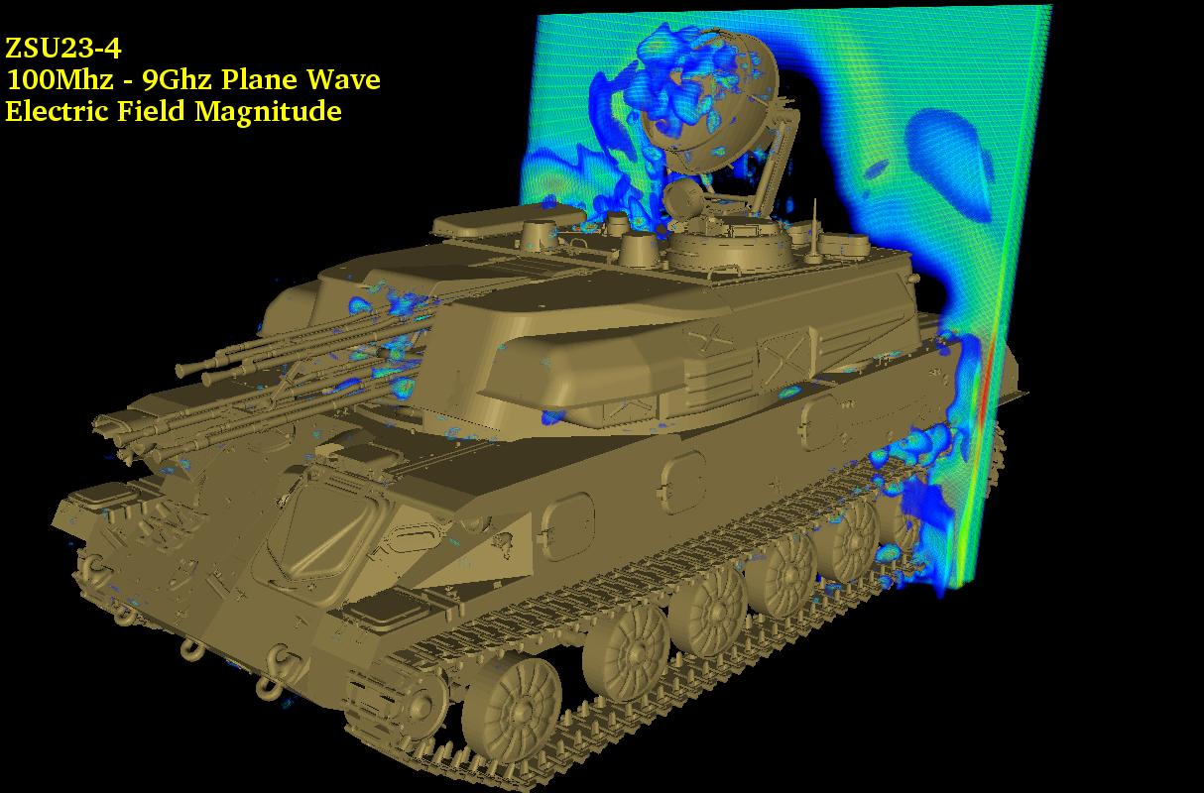
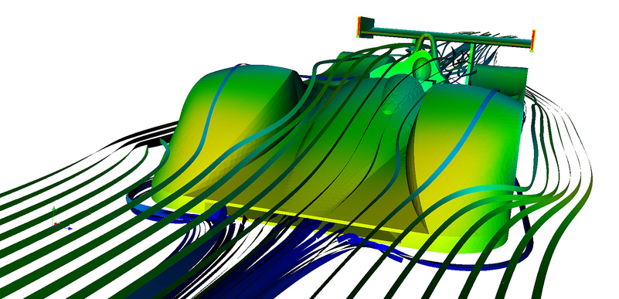
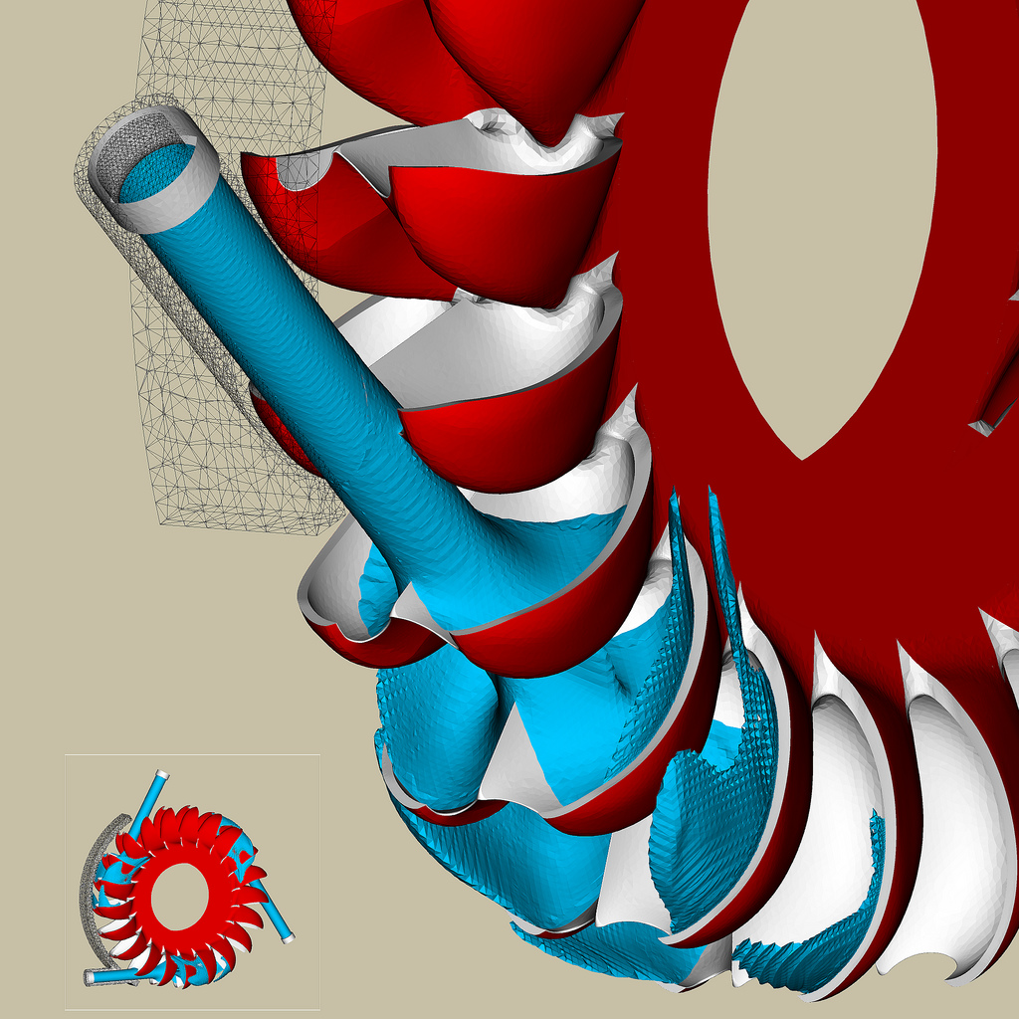
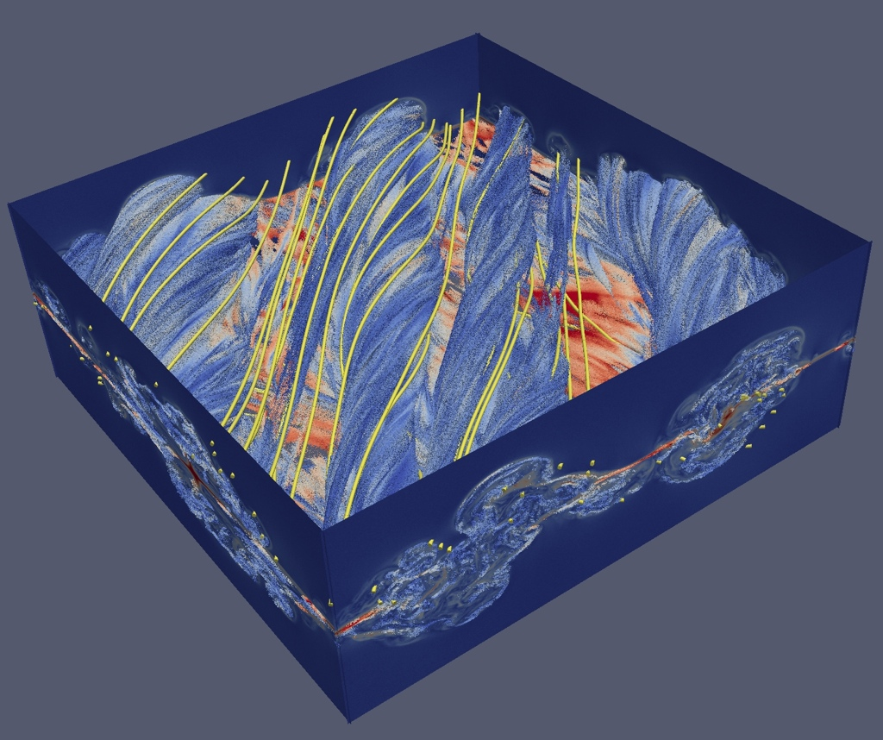
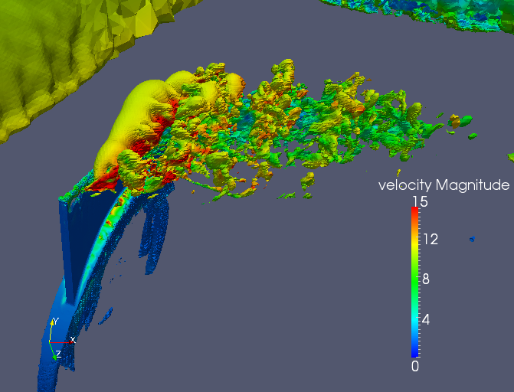
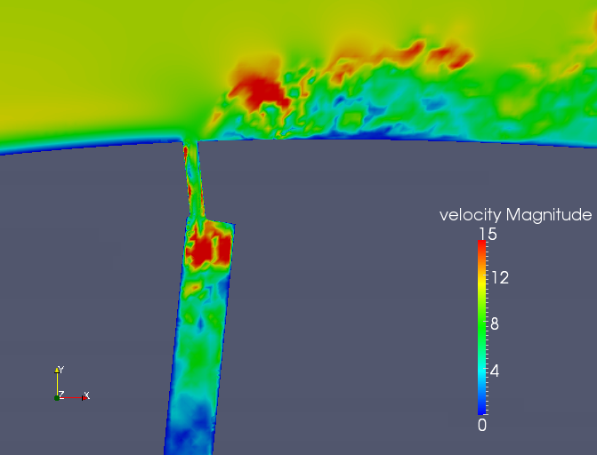
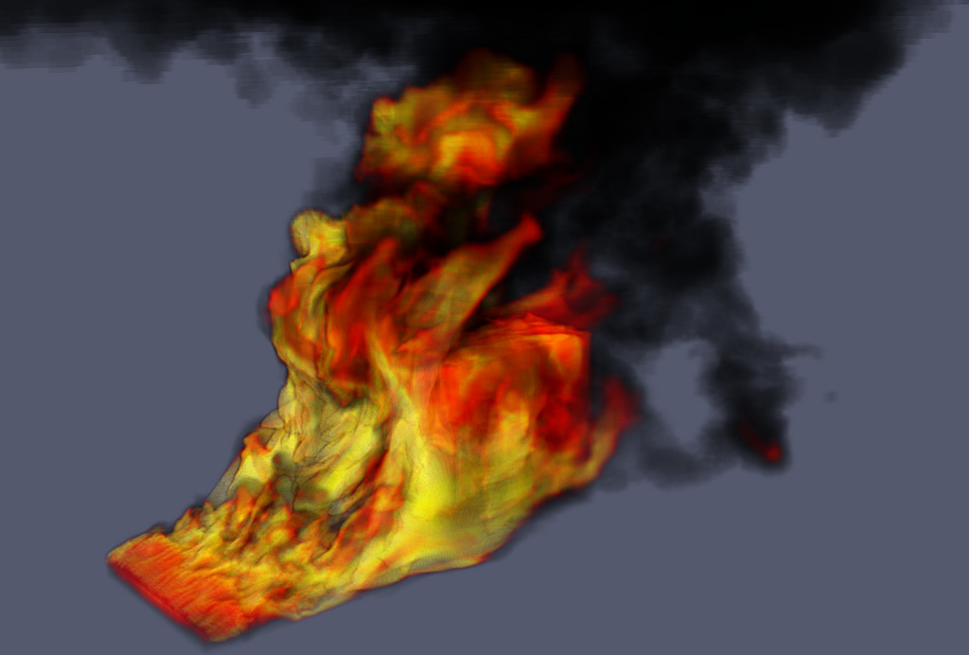
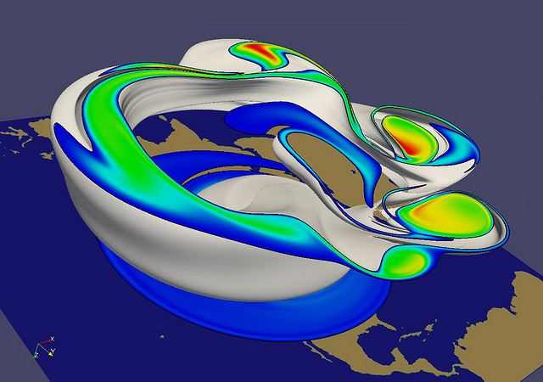
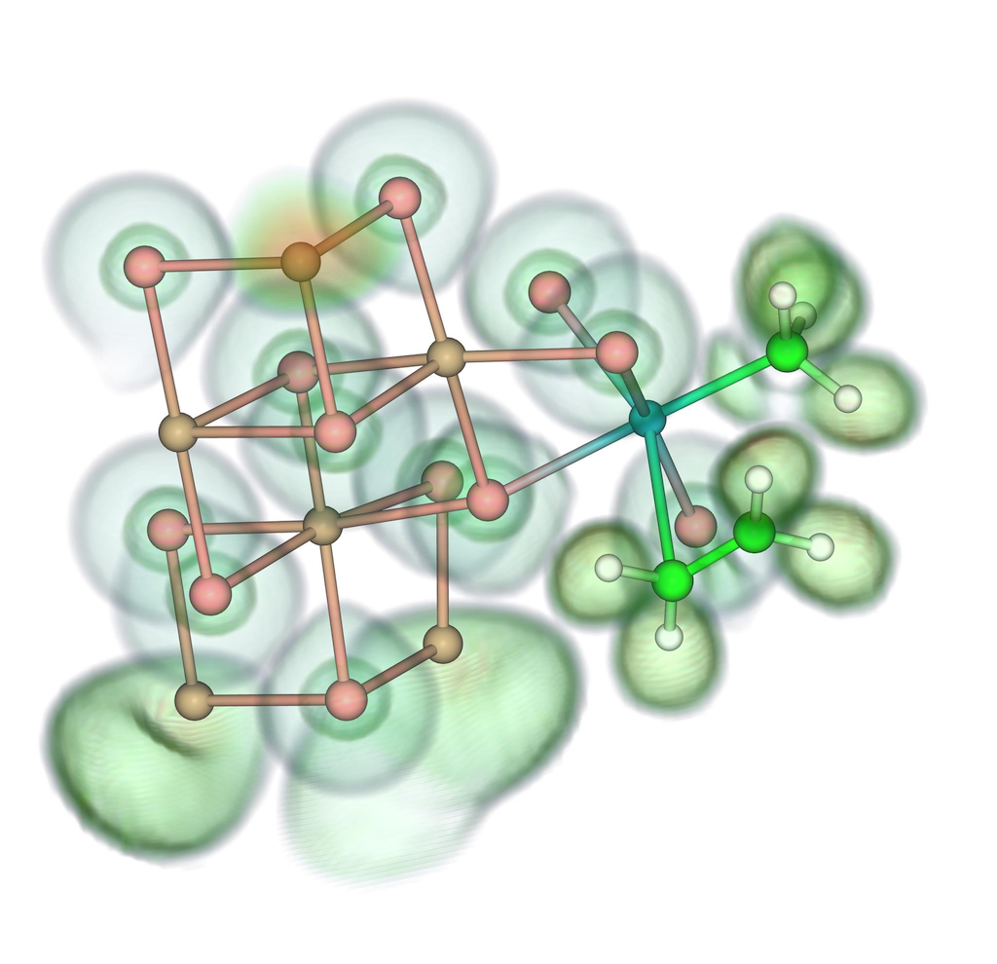
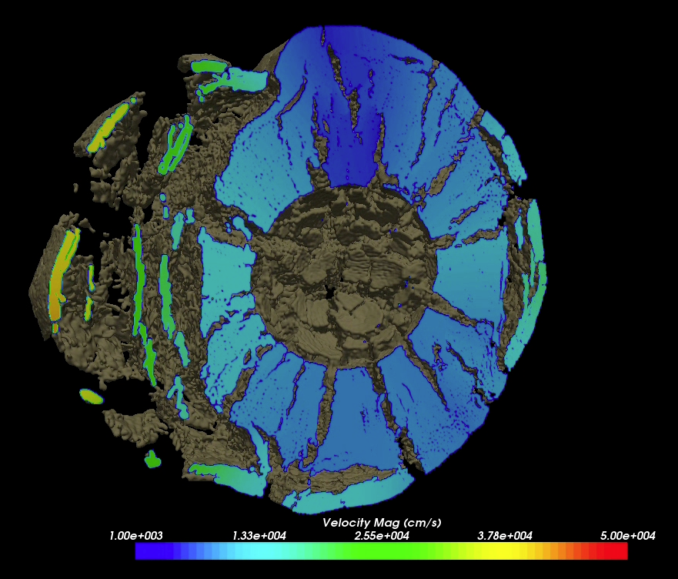
Renato N. Elias, NACAD/COPPE/UFRJ, Rio de Janerio, Brazil
Jerry Clarke, US Army Research Laboratory
Swiss National Supercomputing Centre
Bill Daughton, LANL
Swiss National Supercomputing Centre
Notes:
Small montage of projects using ParaView.
Demonstrates the breadth of utility ParaView has.

Slide 7



Current ParaView Usage
Used by academic, government, and commercial institutions worldwide.
Downloaded ~100K times per year.
HPCwire Editors’ Choice 2010 and HPCwire Readers’ Choice 2010/2012 Awards for Best Visualization Product or Technology.

Slide 8
Data Ranges
Used for all ranges of data size.
Landmarks of SNL usage:
  6 billion structured cells (2005).
  250 million unstructured cells (2005).
  Billions of AMR cells (2008).
  Scaling test over 1 Trillion cells (2010).

Slide 9
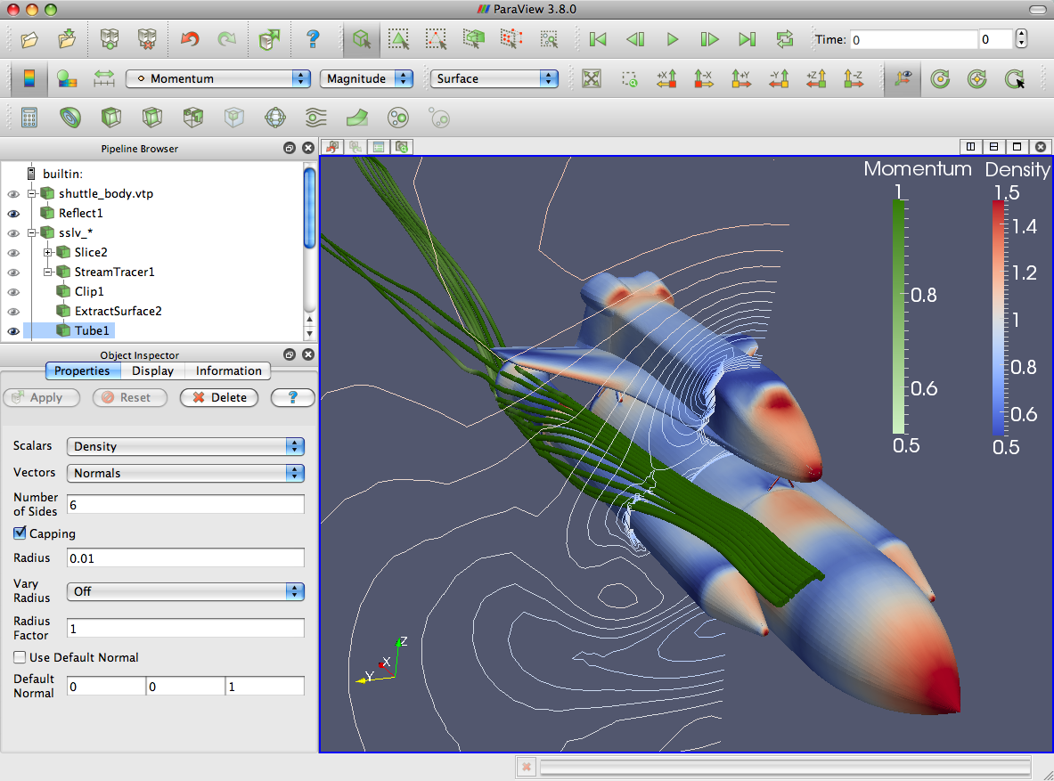
ParaView Application Architecture
ParaView Client
pvpython
ParaWeb
Catalyst
Custom App
UI (Qt Widgets, Python Wrappings)
ParaView Server
VTK
OpenGL
MPI
IceT
Etc.

Slide 10
ParaView Development
Started in 2000 as collaborative effort between Los Alamos National Laboratories and Kitware Inc. (lead by James Ahrens).
  ParaView 0.6 released October 2002.
September 2005: collaborative effort between Sandia National Laboratories, Kitware Inc. and CSimSoft to rewrite user interface to be more user friendly and develop quantitative analysis framework.
  ParaView 3.0 released in May 2007.
ParaView 4.0 released in June 2013.

Slide 11




Current Funding
ARL
ERDC
US Army (SBIR)
US Air Force (STTR)
ONR
Support Contracts
  Electricity de France
  Microsoft
Other contributors
  Swiss National Supercomputing Centre
  DOE SLAC
  Ohio State
  Mississippi State
  RPI

Slide 12
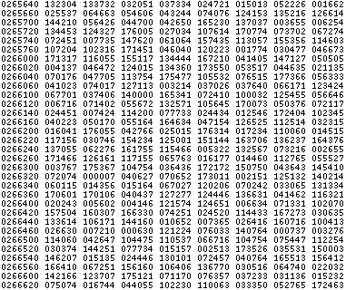
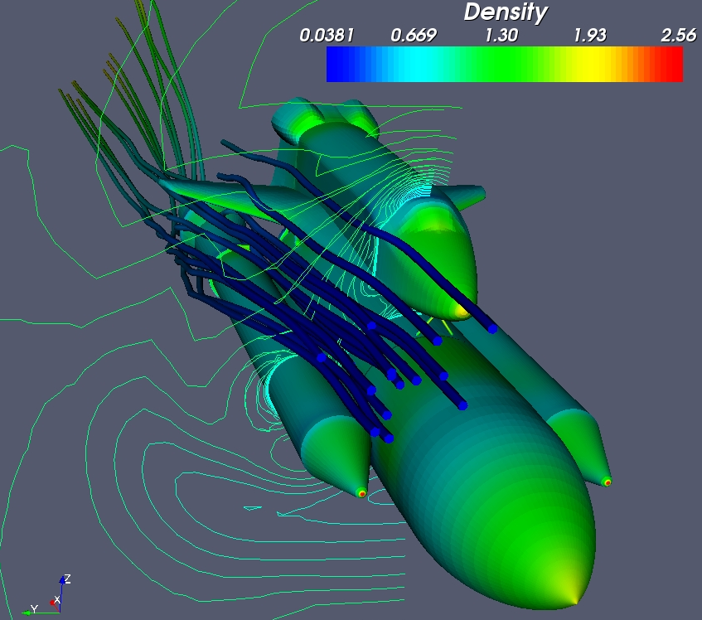
Basics of Visualization

Slide 13
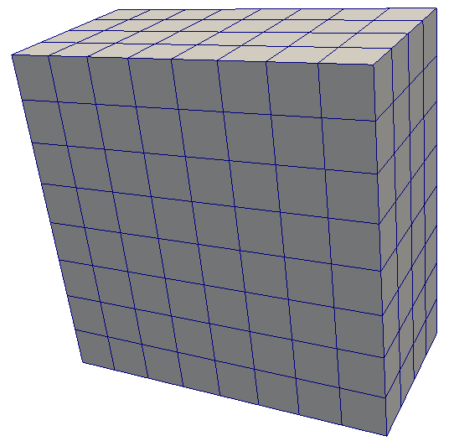
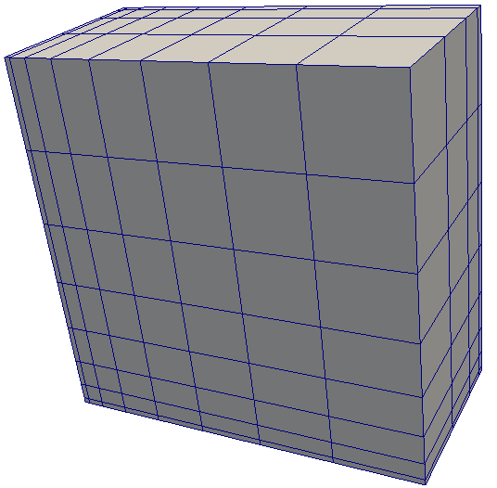
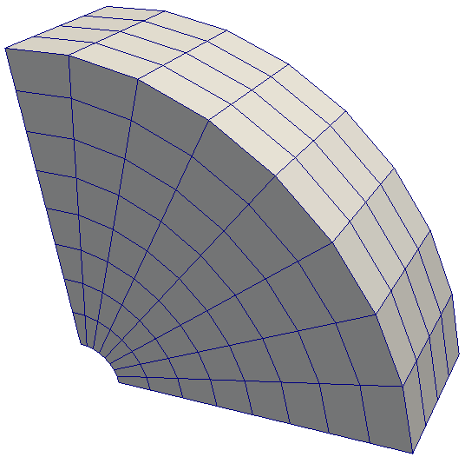
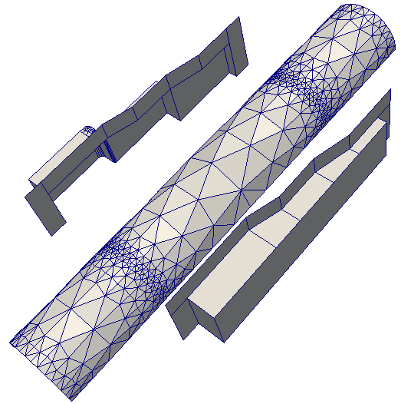
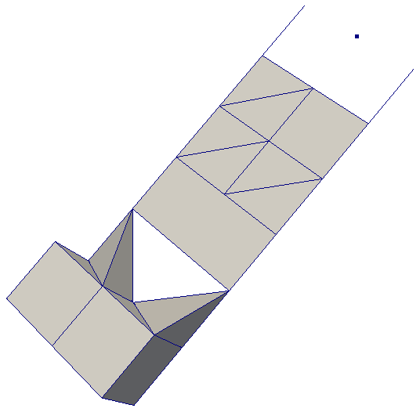
Data Types
Uniform Rectilinear
(vtkImageData)
Non-Uniform Rectilinear
(vtkRectilinearData)
Curvilinear
(vtkStructuredData)
Multi-block
Hierarchical Adaptive Mesh Refinement (AMR)
Hierarchical Uniform AMR
Octree
Polygonal
(vtkPolyData)
Unstructured Grid
(vtkUnstructuredGrid)

Slide 14

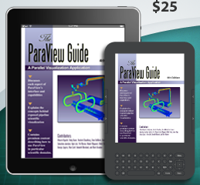
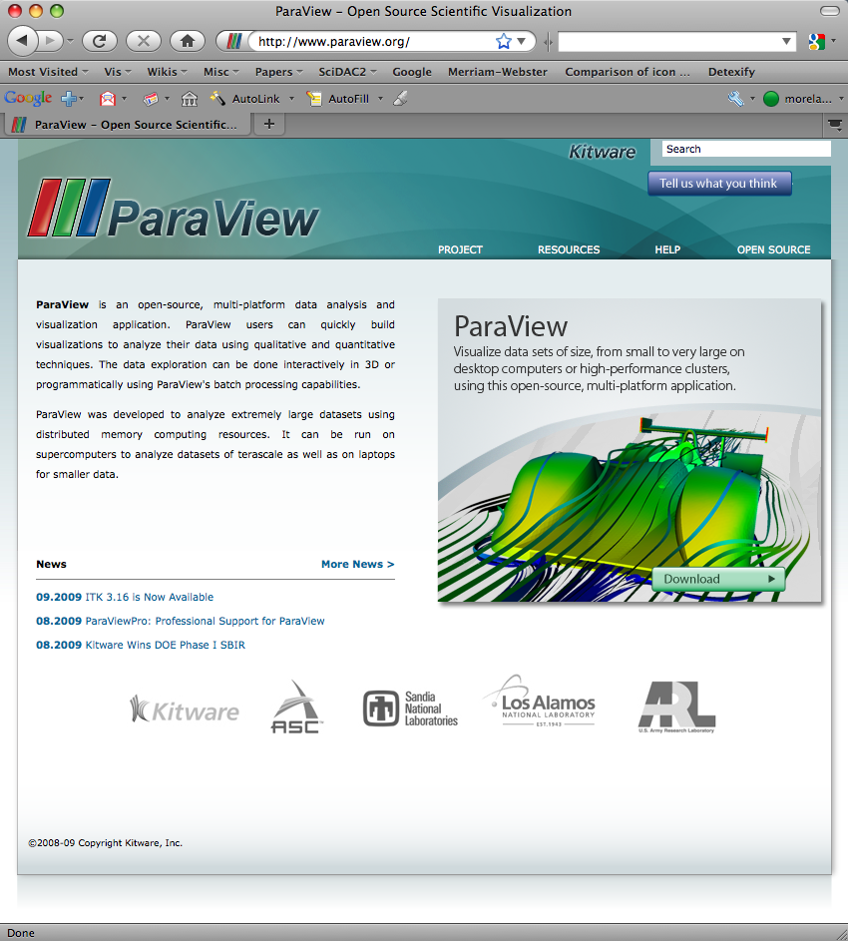
More Information
Online Help – F1
The ParaView User’s Guide
  http://paraview.org/Wiki/ParaView/Users_Guide/Table_Of_Contents
The ParaView web page
  www.paraview.org
ParaView mailing list
  paraview@paraview.org

Slide 15
Basic Usage

Slide 16
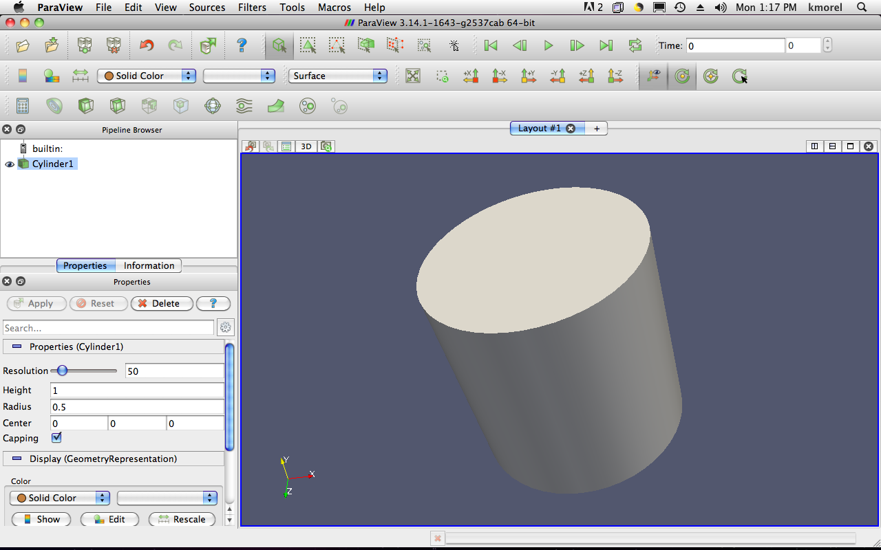
User Interface
Menu Bar
Toolbars
Pipeline Browser
Properties Panel
Advanced Toggle
3D View

Slide 17
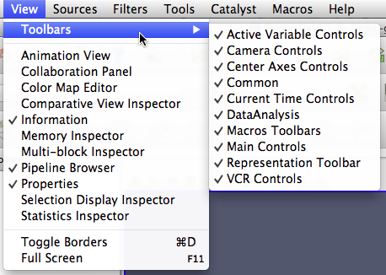
Getting Back GUI Components

Slide 18
Creating a Cylinder Source
Go to the Source menu and select Cylinder.
Click the Apply button to accept the default parameters.

Slide 19


Simple Camera Manipulation
Drag left, middle, right buttons for rotate, pan, zoom.
  Also use Shift, Ctrl, Alt modifiers.

Slide 20
Creating a Cylinder Source
Go to the Source menu and select Cylinder.
Click the Apply button to accept the default parameters.
Increase the Resolution parameter.
Click the button again.

Slide 21
Pipeline Object Controls

Slide 22
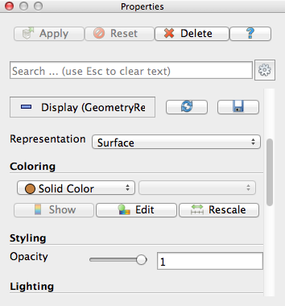
Display Properties

Slide 23
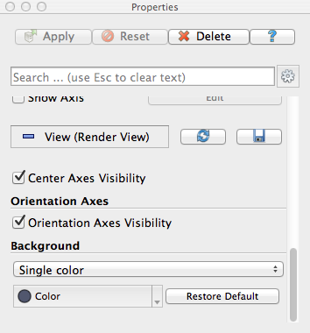
Render View Options

Slide 24




Undo Redo
Undo
Redo
Camera
Undo
Camera
Redo

Slide 25
Creating a Cylinder Source
Go to the Source menu and select Cylinder.
Click the Apply button to accept the default parameters.
Increase the Resolution parameter.
Click the button again.
Delete the Cylinder.

Slide 26
Supported Data Types
ParaView Data (.pvd)
VTK (.vtp, .vtu, .vti, .vts, .vtr)
VTK Legacy (.vtk)
VTK Multi Block (.vtm,.vtmb,.vtmg,.vthd,.vthb)
Partitioned VTK (.pvtu, .pvti, .pvts, .pvtr)
ADAPT (.nc, .cdf, .elev, .ncd)
ANALYZE (.img, .hdr)
ANSYS (.inp)
AVS UCD (.inp)
BOV (.bov)
BYU (.g)
CAM NetCDF (.nc, .ncdf)
CCSM MTSD (.nc, .cdf, .elev, .ncd)
CCSM STSD (.nc, .cdf, .elev, .ncd)
CEAucd (.ucd, .inp)
CMAT (.cmat)
CML (.cml)
CTRL (.ctrl)
Chombo (.hdf5, .h5)
Claw (.claw)
Comma Separated Values (.csv)
Cosmology Files (.cosmo, .gadget2)
Curve2D (.curve, .ultra, .ult, .u)
DDCMD (.ddcmd)
Digital Elevation Map (.dem)
Dyna3D(.dyn)
EnSight (.case, .sos)
Enzo boundary and hierarchy
ExodusII (.g, .e, .exe, .ex2, .ex2v.., etc)
ExtrudedVol (.exvol)
FVCOM (MTMD, MTSD, Particle, STSD)
Facet Polygonal Data
Flash multiblock files
Fluent Case Files (.cas)
GGCM (.3df, .mer)
GTC (.h5)
GULP (.trg)
Gadget (.gadget)
Gaussian Cube File (.cube)
JPEG Image (.jpg, .jpeg)
LAMPPS Dump (.dump)
LAMPPS Structure Files
LODI (.nc, .cdf, .elev, .ncd)
LODI Particle (.nc, .cdf, .elev, .ncd)
LS-DYNA (.k, .lsdyna, .d3plot, d3plot)
M3DCl (.h5)
MFIX Unstructred Grid (.RES)
MM5 (.mm5)
MPAS NetCDF (.nc, .ncdf)
Meta Image (.mhd, .mha)
Miranda (.mir, .raw)
Multilevel 3d Plasma (.m3d, .h5)
NASTRAN (.nas, .f06)
Nek5000 Files
Nrrd Raw Image (.nrrd, .nhdr)
OpenFOAM Files (.foam)
PATRAN (.neu)
PFLOTRAN (.h5)
PLOT2D (.p2d)
PLOT3D (.xyz, .q, .x, .vp3d)
PLY Polygonal File Format
PNG Image Files
POP Ocean Files
ParaDIS Files
Phasta Files (.pht)
Pixie Files (.h5)
ProSTAR (.cel, .vrt)
Protein Data Bank (.pdb, .ent, .pdb)
Raw Image Files
Raw NRRD image files (.nrrd)
SAMRAI (.samrai)
SAR (.SAR, .sar)
SAS (.sasgeom, .sas, .sasdata)
SESAME Tables
SLAC netCDF mesh and mode data
SLAC netCDF particle data
Silo (.silo, .pdb)
Spheral (.spheral, .sv)
SpyPlot CTH
SpyPlot (.case)
SpyPlot History (.hscth)
Stereo Lithography (.stl)
TFT Files
TIFF Image Files
TSurf Files
Tecplot ASCII (.tec, .tp)
Tecplot Binary (.plt)
Tetrad (.hdf5, .h5)
UNIC (.h5)
VASP CHGCA (.CHG)
VASP OUT (.OUT)
VASP POSTCAR (.POS)
VPIC (.vpc)
VRML (.wrl)
Velodyne (.vld, .rst)
VizSchema (.h5, .vsh5)
Wavefront Polygonal Data (.obj)
WindBlade (.wind)
XDMF and hdf5 (.xmf, .xdmf)
XMol Molecule

Slide 27
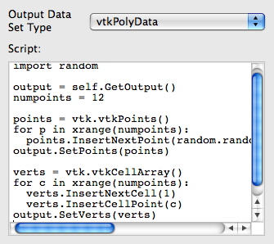
Custom Data Import:
Prototype with Python
A “programmable source” lets you program data readers right in the GUI.
Uses wrappings for the basic VTK classes.
Good for prototyping readers.

Slide 28
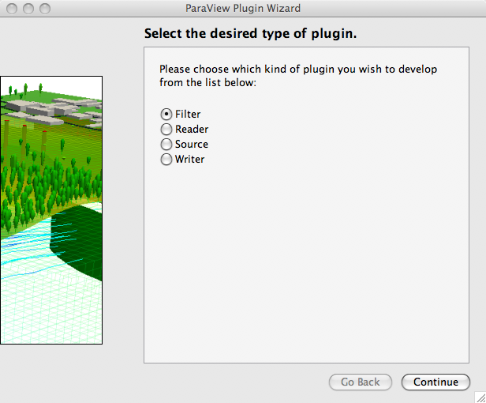
Custom Data Import:
Plugin Containing a Reader
Plugins: shared object libraries that can be dynamically loaded into ParaView.
Any VTK reader object can be added.
For help, try MIRARCO’s Plugin Wizard.
  http://pluginwizard.mirarco.org/

Slide 29
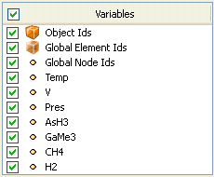
Load disk_out_ref.ex2
Open the file disk_out_ref.ex2.
Load all data variables.
Click

Slide 30
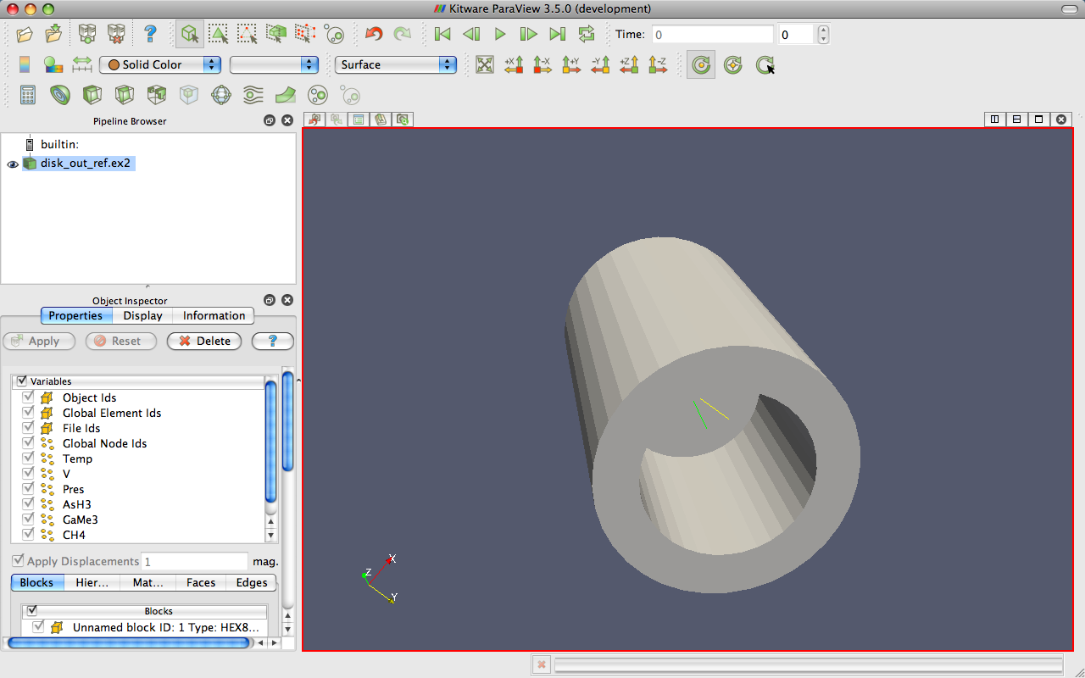
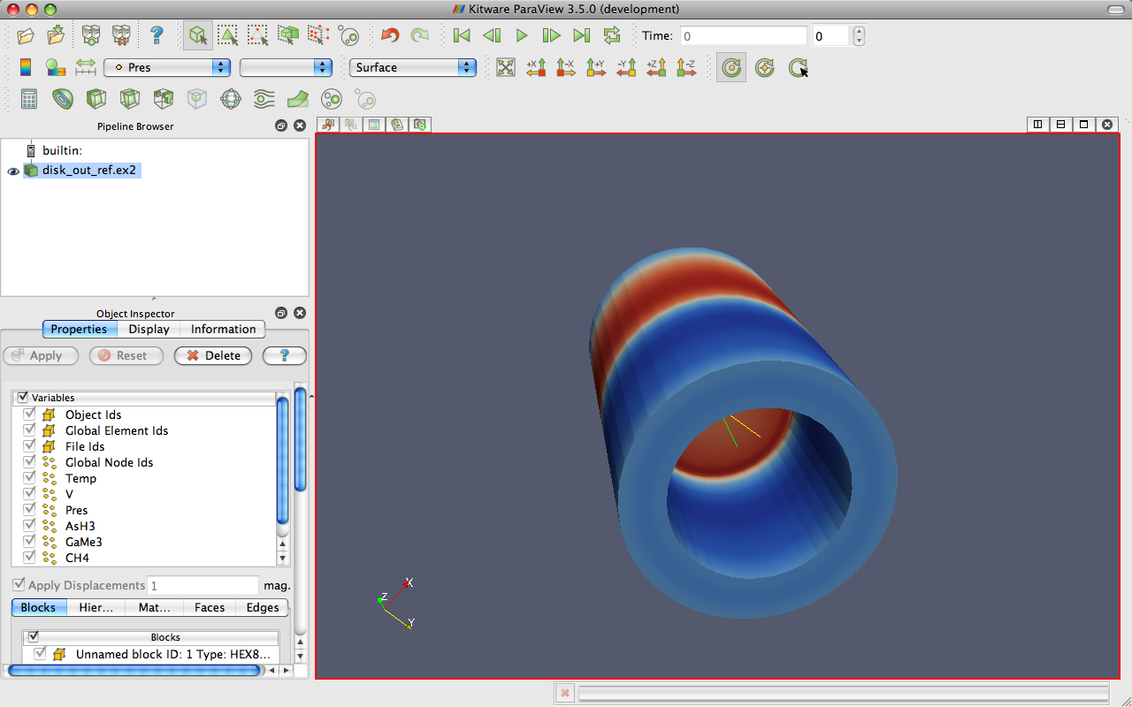
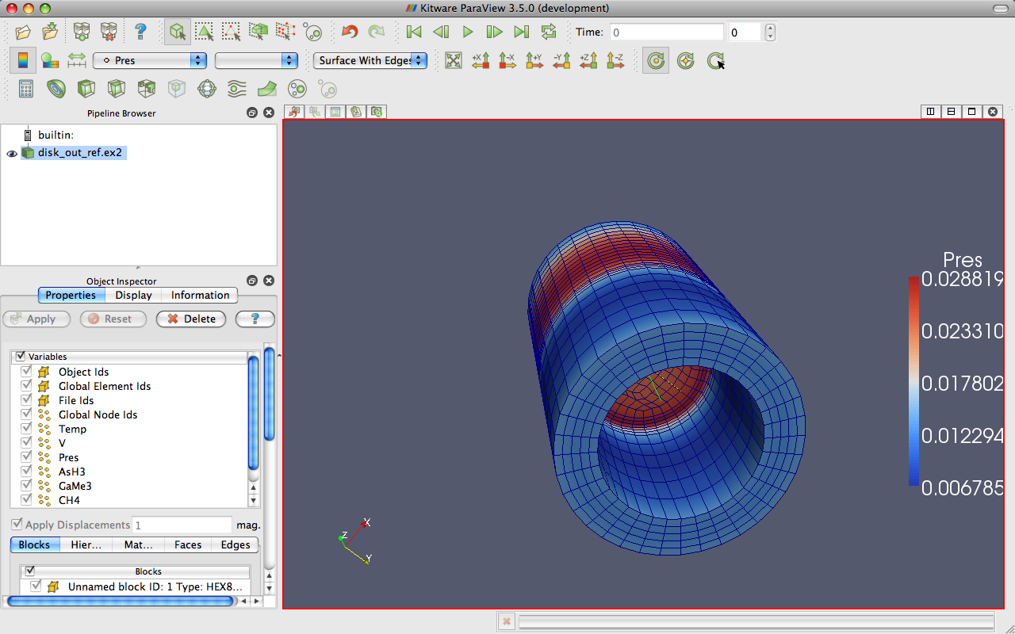
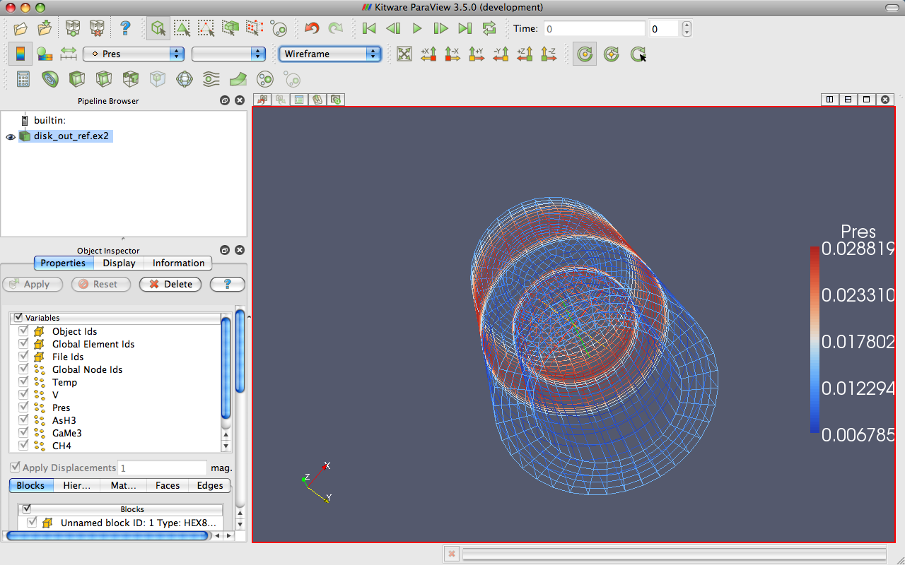
Data Representation
Notes:
Also do volume rendering.

Slide 31
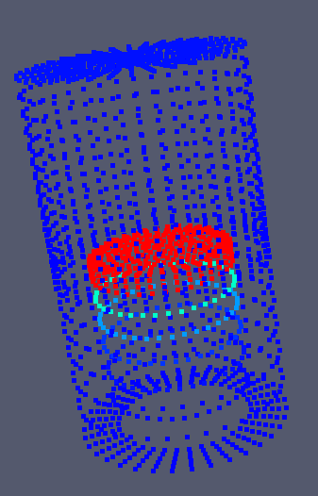
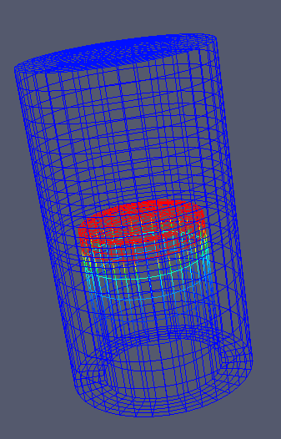
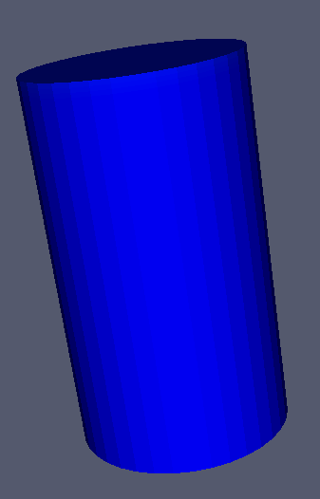
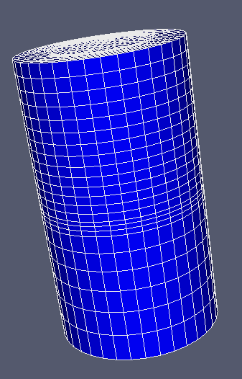
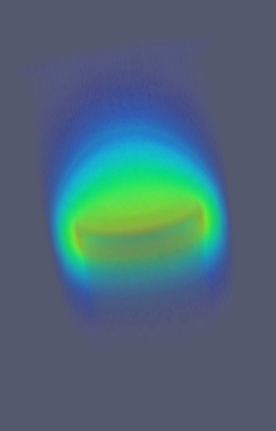
Geometry Representations
Points
Wireframe
Surface
Surface
with Edges
Volume

Slide 32











Common Filters
Calculator
Contour
Clip
Slice
Threshold
Extract Subset
Glyph
Stream Tracer
Warp (vector)
Group Datasets
Extract Level

Slide 33
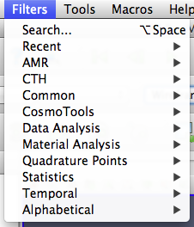
Filters Menu

Slide 34
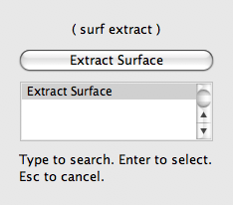
Quick Launch
Used for searching for filters by name
Keyboard shortcut
  Ctrl-space for Windows & Linux
  Alt-space for Mac
Notes:
ctrl-space: Win/Linux. alt-space: Mac

Slide 35
Apply a Filter
Make sure that disk_out_ref.ex2 is selected in the pipeline browser.
Select the contour filter.

Slide 36
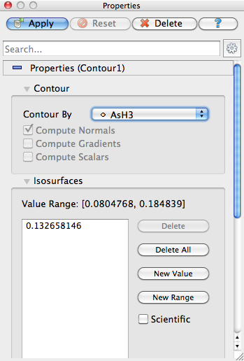
Apply a Filter
Change parameters to create an isosurface at Temp = 400K.
Change to Temp
Change to 400

Slide 37
Apply a Filter
Make sure that disk_out_ref.ex2 is selected in the pipeline browser.
Select the contour filter.
Change parameters to create an isosurface at Temp = 400K.

Slide 38
Create a Cutaway Surface
Select disk_out_ref.ex2 in the pipeline browser.
From the quick launch, select Extract Surface.

Slide 39
Create a Cutaway Surface
Select disk_out_ref.ex2 in the pipeline browser.
From the quick launch, select Extract Surface.
Create a clip filter.
Uncheck Show Plane.

Slide 40
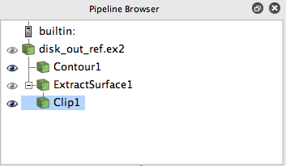
Pipeline Browser Structure
disk_out_ref.ex2
DataSetSurfaceFilter1
Contour1
Clip1
Notes:
Mention eyeballs

Slide 41
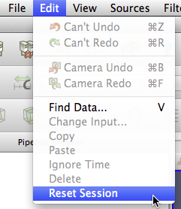
Reset ParaView
Edit → Reset Session

Slide 42

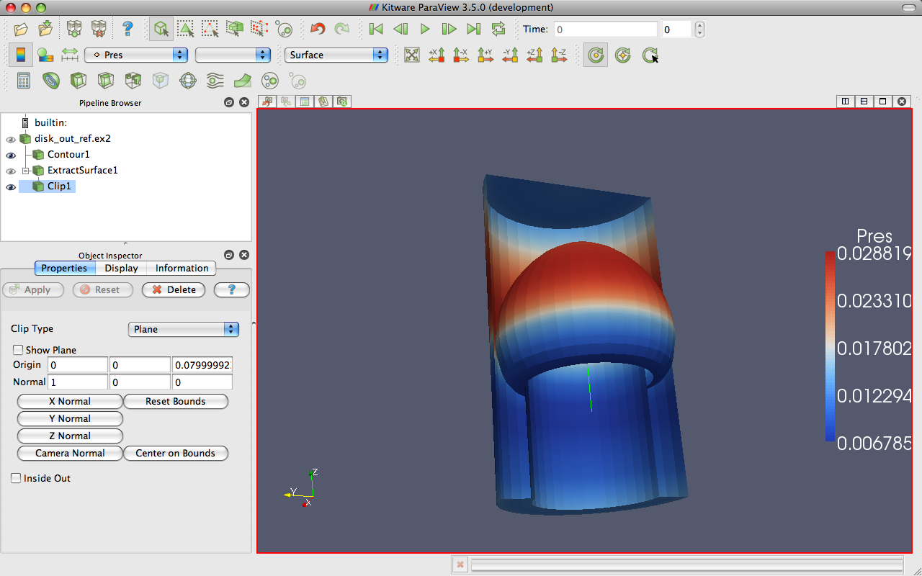
Multiview

Slide 43
Multiview
Open disk_out_ref.ex2. Load all variables.
Add Clip filter.
Uncheck Show Plane.
Color surface by Pres.

Slide 44
Multiview
Split the view horizontally.
Make Clip1 visible.
Color surface by Temp.
Notes:
Problem: camera position different in each view.

Slide 45
Multiview
Split the view horizontally.
Make Clip1 visible.
Color surface by Temp.
Right-click view, Link Camera…
Click other view.

Slide 46

Multiview
Split the view horizontally.
Make Clip1 visible.
Color surface by Temp.
Right-click view, Link Camera…
Click other view.
Click

Slide 47
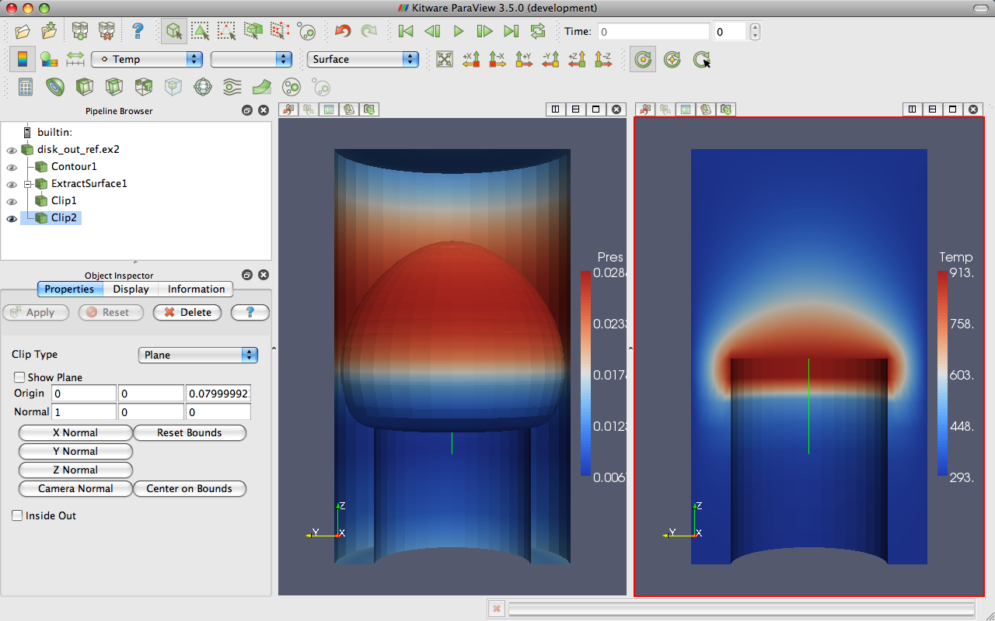
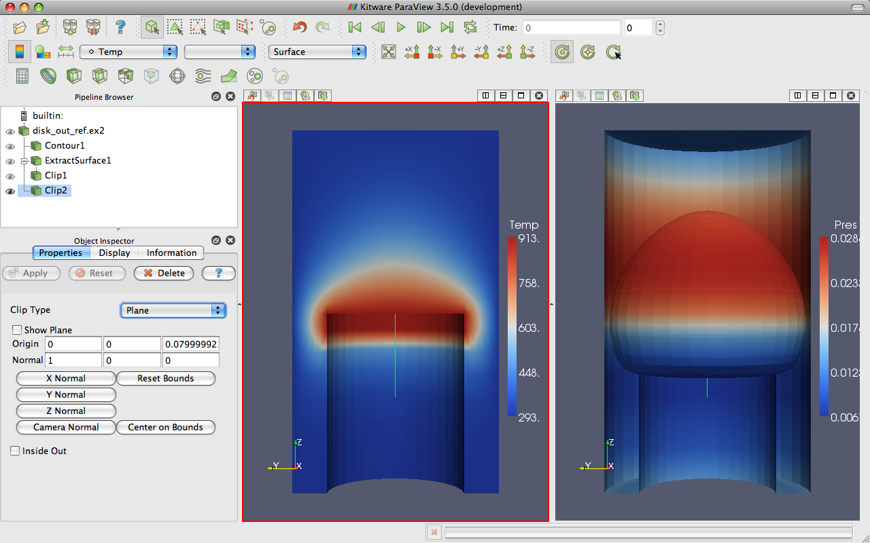
Modifying Views

Slide 48
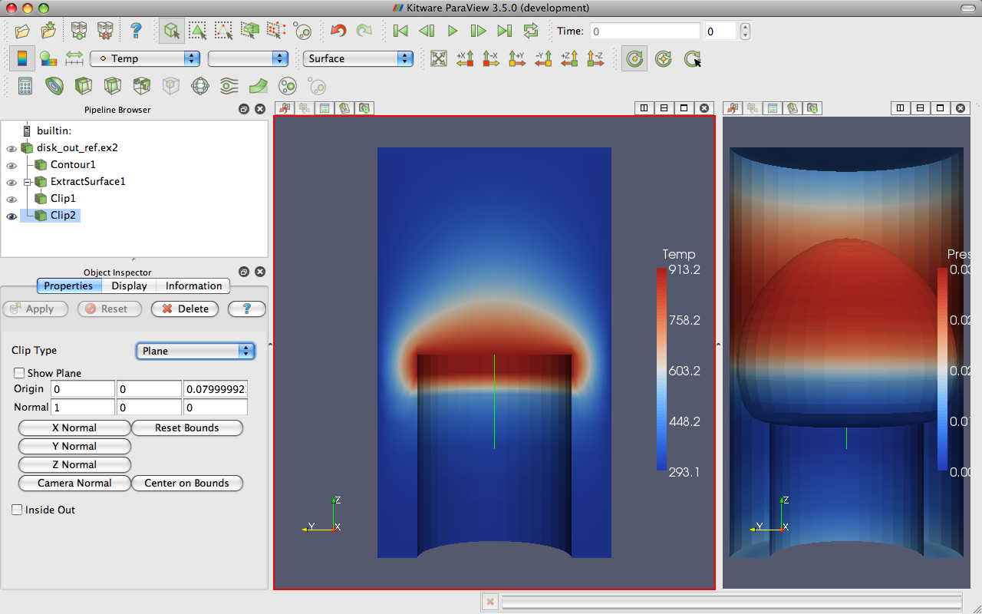
Modifying Views

Slide 49
Reset ParaView
Edit → Reset Session

Slide 50
Streamlines
Open disk_out_ref.ex2. Load all variables.
Add Stream Tracer.

Slide 51
Streamlines
Open disk_out_ref.ex2. Load all variables.
Add Stream Tracer.
From the quick launch, select Tube

Slide 52
Getting Fancy
Select StreamTracer1.
Add Glyph filter.
Change Vectors to V.
Change Glyph Type to Cone.

Slide 53
Getting Answers
Where is the air moving the fastest? Near the disk or away from it? At the center of the disk or near its edges?
Which way is the plate spinning?
At the surface of the disk, is air moving toward the center or away from it?

Slide 54
Reset ParaView
Edit → Reset Session

Slide 55

Common Data Analysis Filters
Extract Selection
Plot Global Variables Over Time
Plot Over Line
Plot Selection Over Time
Probe Location

Slide 56
Plotting
Open disk_out_ref.ex2. Load all variables.
Clip, uncheck, ,
Select disk_out_ref.ex2.
Add Plot Over Line filter.

Slide 57
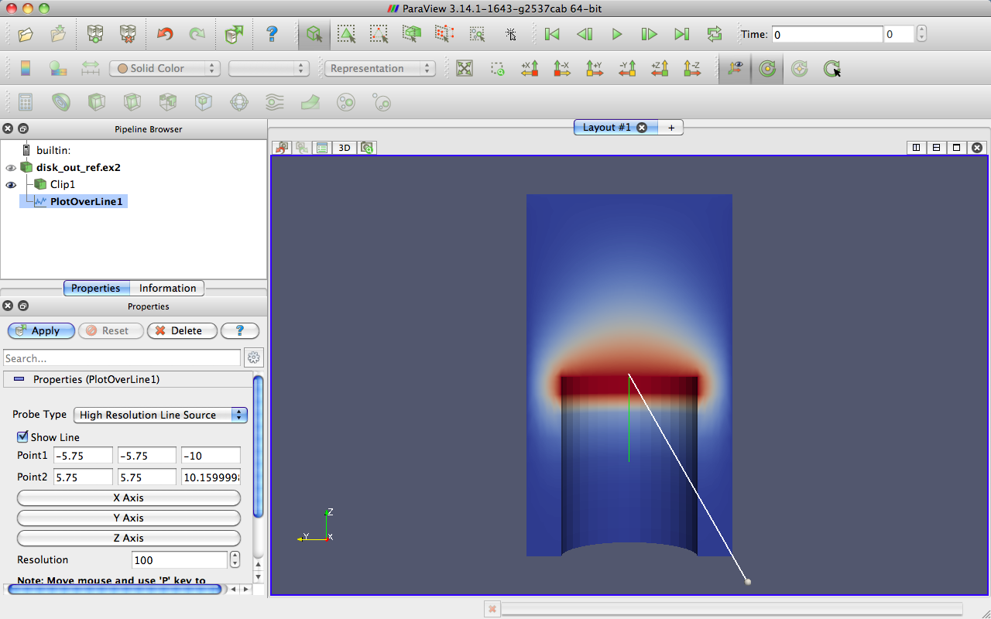
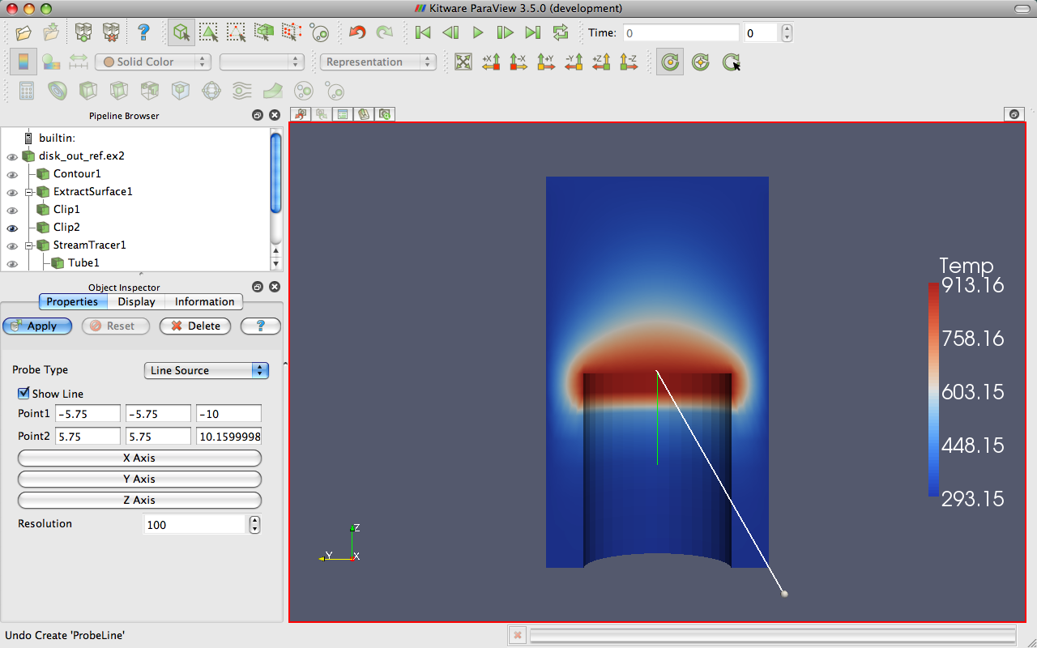
3D Widgets

Slide 58
Plotting
Open disk_out_ref.ex2. Load all variables.
Clip, uncheck, ,
Select disk_out_ref.ex2.
Add Plot Over Line filter.
Once line is satisfactorily located,

Slide 59

Interacting with Plots
Left, middle, right buttons to pan, zoom.
Mouse wheel to zoom.
Reset view to plot ranges.

Slide 60
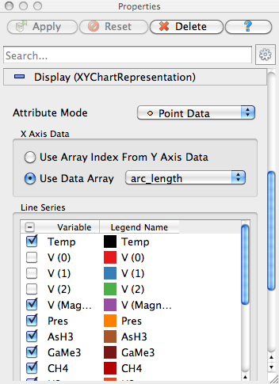
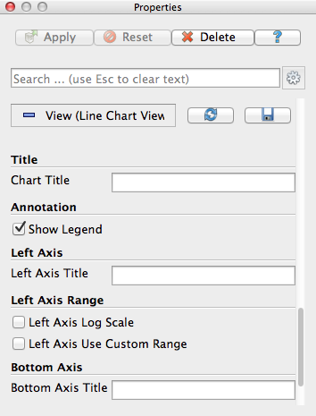
Plots are Views
Move them like Views.
Save screenshots.

Slide 61
Adjusting Plots
In Display section of properties panel, turn off all variables except Temp and Pres.
Select Pres in the Display options.
Change Chart Axis to Bottom – Right.
Verify the relationship between temperature and pressure.
Notes:
From here, re-verify relationship of temperature and pressure.

Slide 62

Histogram / Bar Chart
Select disk_out_ref.ex2.
Filters → Data Analysis → Histogram
Change Input Array to Temp.

Slide 63
Geometry Representations
Points
Wireframe
Surface
Surface
with Edges
Volume

Slide 64
Reset ParaView
Edit → Reset Session

Slide 65
Volume Rendering +
Surface Geometry
Open disk_out_ref.ex2. Load all variables.
Change variable viewed to Temp.
Change representation to Volume.

Slide 66
Volume Rendering +
Surface Geometry
Open disk_out_ref.ex2. Load all variables.
Change variable viewed to Temp.
Change representation to Volume.
Add Stream Tracer.
Optional: Add Tubes and Glyphs.

Slide 67


Transfer Function Editor
Notes:
Add control points by clicking in color box.
Drag control points to move them.
Delete active point by hitting backspace or delete.
Click active point to change its color.
Can save and load transfer functions.
Load black-body radiation.

Slide 68

Modify Transfer Function
Select disk_out_ref.ex2.
Click Edit Color Map .
Click Choose preset .
Select Black-Body Radiation. Close.
Try adding and changing control points.

Slide 69
Reset ParaView
Edit → Reset Session

Slide 70



Loading Data with Time
Open the file can.ex2.
Select all variables.

Slide 71
Animation Toolbar

Slide 72


Animation Pitfall
Go to first time step.
Color by EQPS variable.
Play (or skip to last time step ).

Slide 73

Animation Pitfall
Go to first time step.
Color by EQPS variable.
Play (or skip to last time step ).
Fix with Rescale to Data Range.

Slide 74

Data Range Workarounds
Go to representative time and hit
In Settings change On File Open to Goto last timestep.

Slide 75
Data Range Workarounds
Open color scale editor dialog
Set a custom range.

Slide 76
Data Range Workarounds
Open color scale editor dialog
Rescale to range over all timesteps

Slide 77
Reset ParaView
Edit → Reset Session

Slide 78

Animation View
View → Animation View

Slide 79
Animation View
View → Animation View
Animation Modes: Sequence, Real Time, and Snap To TimeSteps

Slide 80
Changing Animation Timing
Open can.ex2. Load all variables.
Change animation mode to Real Time.
  Default animation time is 10 sec.

Slide 81
Changing Animation Timing
Open can.ex2. Load all variables.
View → Animation View
Change Mode to Real Time.
  Default animation duration is 10 sec.

Slide 82
Changing Animation Timing
Open can.ex2. Load all variables.
View → Animation View
Change Mode to Real Time.
  Default animation duration is 10 sec.
Change Duration to 60 sec.
again.

Slide 83
Smoothing the Animation
Make sure can.ex2 highlighted.
From the quick launch, select Temporal Interpolator.
Split view. Show can.ex2 in one and TemporalInterpolator1 in the other. Link the cameras.

Slide 84
Adding Text Annotation
If you fell behind, you can reset ParaView and reload can.ex2.
Sources → Text
Type a message in text edit box

Slide 85

Text Position
Notes:
You can move text around with the mouse or pick a standard window location.

Slide 86
Annotate Time
Sources → Annotate Time

Slide 87
Annotate Time
Sources → Annotate Time
Select can.ex2
From quick dialog, select Annotate Time Filter
Move annotation around.

Slide 88
Save Screenshot/Animation
Choose File → Save Screenshot
Complete the following dialogs.
Turn on Cube Axes around can.
Chose File → Export Scene
Complete the following dialogs.
Chose File → Save Animation
Complete the following dialogs.

Slide 89

Color Palettes

Slide 90
Reset ParaView
Edit → Reset Session

Slide 91
Query-Based Selection
Open can.ex2. All variables.
Go to last time step.
Edit → Find Data.
Top combo box: find Cells.
Next row: EQPS, is >=, and 1.5.
Click Run Selection Query.

Slide 92

Query-Based Selection

Slide 93




Brush Selection
Surface Cell Selection (shortcut: s)
Surface Point Selection
Through Cell Selection
Through Point Selection
Select Points (polygon)
Select Cells (polygon)
Block Selection (shortcut: b)
Notes:
Rubber band selection tools and polygon selection tools which create polygon by dragging

Slide 94
Selections
Open Find Data.
Make various brush selections.
Observe results in the Find Data dialog box.
Play with the Invert Selection and Show Frustum options.
Notes:
You may want to move the Selection Inspector

Slide 95
Frustum vs. Id Selections
Make a Select Cells Through
Turn on Show Frustum in Find Data. Rotate 3D view.
Play
Hit Freeze Selection in Find Data.
Play

Slide 96
Adding Labels
Go to the last time step.
Open Find Data.
Create query Global ID is min. Click Run Selection Query.
In the Cell Labels chooser, select EQPS.

Slide 97
Plot Selection Over Time
Open Find Data.
Create query EQPS is max. Click Run Selection Query.
Click Plot Selection Over Time
In Display controls, turn off all plot series except for max(EQPS).

Slide 98
Reset ParaView
Edit → Reset Session

Slide 99

Extracting a Selection
Open can.ex2. Load all variables.
Perform a sizeable selection.
Add the extract selection filter.

Slide 100
Reset ParaView
Edit → Reset Session

Slide 101
Make an Animation
Sources → Sphere,
Make animation view visible.
Change No. Frames to 50.
Select Sphere1, Start Theta, press

Slide 102
Make an Animation
Sources → Sphere,
Make animation view visible.
Change No. Frames to 50.
Select Sphere1, Start Theta, press
Double-click Sphere1 – Start Theta
Make New keyframe.
First keyframe value→360, second keyframe time→0.5 value→0.
Click OK.

Slide 103
Animating Two Properties
Open Sphere1 – Start Theta.
Delete the first keyframe (at time 0).
Click OK.
Select Sphere1 – End Theta, press
Open Sphere1 – End Theta.
Change second key frame time to 0.5.

Slide 104
Camera Orbit
Place the camera where the orbit should start.
Make animation view visible.
Select Camera – Orbit, press
Accept default values (click OK).

Slide 105
Reset ParaView
Edit → Reset Session

Slide 106
Following Data
Open can.ex2. Load all variables.
Make animation view visible.
Select Camera – Follow Data, press

Slide 107
Batch Scripting

Slide 108
Python Batch Scripting
Interpreter: Tools → Python Shell.
  External programs pvpython and pvbatch.
  Can add bindings to external interpreters.
Run Python scripts or bind to macros.
Can trace actions or capture state.
(Batch scripting is a different set of bindings than programmable sources/filters.)

Slide 109
Reset ParaView
Edit → Reset Session

Slide 110
Tracing ParaView State
Select Tools → Start Trace.
Accept defaults (click OK).
Build a simple pipeline (e.g. create a sphere source and clip it).
Select Tools → Stop Trace.
An editing window will open.

Slide 111
Adding a Macro
In Python edit window menu, select File → Save As Macro…
Chose a descriptive name. Save in directory provided.
Close Python edit window.
Select Edit → Reset Session.
Activate your macro (on toolbar or Macros menu).

Slide 112

Python Tracing Options

Slide 113
Visualizing Large Models

Slide 114

Golevka Asteroid vs.
10 Megaton Explosion
CTH shock physics, over 1 billion cells

Slide 115

Polar Vortex Breakdown
SEAM Climate Modeling, 1 billion cells (500 million cells visualized).

Slide 116

Objects-in-Crosswind Fire
Coupled SIERRA/Fuego/Syrinx/Calore, 10 million unstructured hexahedra

Slide 117

Large Scale AMR
Notes:
Works on huge numbers of cells in an uncharacteristically large number of blocks
Working with data containing 10’s of thousands to 100’s of thousands of blocks and billions of cells.

Slide 118


Wing with Unsteady Crossflow from Synthetic Jet (3.3B tet)
Notes:
Simulation of flow over a full wing where a synthetic jet issues unsteady crossflow jet at 1750Hz.
3.3 billion tetrahedra
Run in situ with PHASTA simulation on 160 thousand cores.

Slide 119
ParaView Architecture
Three tier
  Data Server
  Render Server
  Client

Slide 120
Standalone
Client
Data
Server
Render
Server

Slide 121
Client-Server
Data
Server
Render
Server
Client

Slide 122
Client-Render Server-Data Server
Data
Server
Render
Server
Client

Slide 123
Requirements for
Installing ParaView Server
C++
CMake (www.cmake.org)
MPI
OpenGL (or Mesa3D www.mesa3d.org)
Qt 4.7 (optional)
Python +NumPy +Matplotlib (optional)
http://www.paraview.org/Wiki/Setting_up_a_ParaView_Server#Compiling

Slide 124



Connecting to a ParaView Server
http://www.paraview.org/Wiki/Setting_up_a_ParaView_Server#Running_the_Server

Slide 125
Data Parallel Pipelines
Duplicate pipelines run independently on different partitions of data.

Slide 126
Data Parallel Pipelines
Duplicate pipelines run independently on different partitions of data.

Slide 127
Data Parallel Pipelines
Some operations will work regardless.
  Example: Clipping.

Slide 128
Data Parallel Pipelines
Some operations will work regardless.
  Example: Clipping.

Slide 129
Data Parallel Pipelines
Some operations will work regardless.
  Example: Clipping.

Slide 130
Data Parallel Pipelines
Some operations will have problems.
  Example: External Faces

Slide 131
Data Parallel Pipelines
Some operations will have problems.
  Example: External Faces

Slide 132
Data Parallel Pipelines
Ghost cells can solve most of these problems.

Slide 133
Data Parallel Pipelines
Ghost cells can solve most of these problems.

Slide 134
Data Partitioning
Partitions should be load balanced and spatially coherent.

Slide 135
Data Partitioning
Partitions should be load balanced and spatially coherent.

Slide 136
Data Partitioning
Partitions should be load balanced and spatially coherent.

Slide 137


Load Balancing/Ghost Cells
Automatic for Structured Meshes.
Partitioning/ghost cells for unstructured is “manual.”
Use the D3 filter for unstructured
  (Filters → Alphabetical → D3)

Slide 138
Job Size Rules of Thumb
Structured Data
  Try for max 20 M cell/processor.
  Shoot for 5 – 10 M cell/processor.
Unstructured Data
  Try for max 1 M cell/processor.
  Shoot for 250 – 500 K cell/processor.

Slide 139
Avoiding Data Explosion
Pipeline may cause data to be copied, created, converted.
This advice only for dealing with very large amounts of data.
  Remaining available memory is low.

Slide 140
Topology Changing, No Reduction
Append Datasets
Append Geometry
Clean
Clean to Grid
Connectivity
D3
Delaunay 2D/3D
Extract Edges
Linear Extrusion
Loop Subdivision
Reflect
Rotational Extrusion
Shrink
Smooth
Subdivide
Tessellate
Tetrahedralize
Triangle Strips
Triangulate
Notes:
Ribbon and Tube
Use with caution on unstructured data
Never use with structured data

Slide 141
Topology Changing,
Moderate Reduction
Clip
Decimate
Extract Cells by Region
Extract Selection
Quadric Clustering
Threshold
Similar: Extract Subset
Notes:
Use with caution on unstructured data.
Use with extreme caution on structured data.

Slide 142
Topology Changing,
Dimension Reduction
Cell Centers
Contour
Extract CTH Fragments
Extract CTH Parts
Extract Surface
Feature Edges
Mask Points
Outline (curvilinear)
Slice
Stream Tracer
Notes:
Usually safe with unstructured data.
Requires only mild caution with structured data.

Slide 143
Adds Field Data
Block Scalars
Calculator
Cell Data to Point Data
Compute Derivatives
Curvature
Elevation
Generate Ids
Gen. Surface Normals
Gradient
Level Scalars
Median
Mesh Quality
Octree Depth Limit
Octree Depth Scalars
Point Data to Cell Data
Process Id Scalars
Random Vectors
Resample with dataset
Surface Flow
Surface Vectors
Texture Map to…
Transform
Warp (scalar)
Warp (vector)
Notes:
Usually safe on all data.

Slide 144

Total Shallow Copy or
Output Independent of Input
Annotate Time
Append Attributes
Extract Block
Extract Datasets
Extract Level
Glyph
Group Datasets
Histogram
Integrate Variables
Normal Glyphs
Outline
Outline Corners
Plot Global Variables Over Time
Plot Over Line
Plot Selection Over Time
Probe Location
Temporal Shift Scale
Temporal Snap-to-Time-Steps
Temporal Statistics

Slide 145

Special Cases
Temporal Filters
  Temporal Interpolator
  Particle Tracer
  Temporal Cache
Programmable Filter

Slide 146
Culling Data
Reduce dimensionality early.
  Contour and slice “see” inside volumes.
Prefer data reduction over extraction.
  Slice instead of Clip.
  Contour instead of Threshold.
Only extract when reducing an order of magnitude or more.
  Can still run into troubles.

Slide 147
Culling Data
Experiment with subsampled data.
  Extract Subset
Use caution.
  Subsampled data may be lacking.
  Use full data to draw final conclusions.

Slide 148

Memory Inspector

Slide 149
Rendering Modes
Still Render
  Full detail render.
Interactive Render
  Sacrifices detail for speed.
  Provides quick rendering rate.
  Used when interacting with 3D view.

Slide 150



Level of Detail (LOD)
Geometric decimation
Used only with Interactive Render
Original Data
Default Decimation
Maximum Decimation

Slide 151

3D Rendering Parameters
Edit → Settings, Render View

Slide 152





Parallel Rendering
Notes:
IceT
Sort-last -> image compositing
Insensitive to iamge data size

Slide 153




Parallel Rendering

Slide 154









Tiled Displays

Slide 155




Image Size LOD
ParaView’s parallel rendering overhead proportional to image size.
Can use smaller images for interactive rendering.
Original Data
Subsample Rate: 2 pixels
Subsample Rate: 4 pixels
Subsample Rate: 8 pixels

Slide 156

Parallel Rendering Parameters
Edit → Settings, Render View

Slide 157
Parameters for Large Data
Use display lists for GPU, off for CPU.
Try outline instead of decimated geometry.
  Also try lowering decimation factor.
Avoid shipping large data back to client.
Turn on subsampling.
Image Compression on.

Slide 158
Parameters for Low Bandwidth
  Try larger subsampling rates.
Try Zlib compression and fewer bits.

Slide 159
Parameters for High Latency
Turn up Remote Render Threshold.
  Allow more data to go to client.
Play with the LOD Threshold and LOD Resolution to control geometry sent to client.
Turn on Use outline for LOD rendering if decimated geometry too big for client.
Try turning on interactive render delay.

Slide 160

ParaView Catalyst

Slide 161
Why In Situ?
System Parameter | 2011 | “2018” |  | Factor Change
System peak | 2 PF | 1 EF |  | 500
Power | 6 MW | ≤20 MW |  | 3
System Memory | 0.3 PB | 32-64 PB |  | 33
Node Performance | 0.125 Tf/s | 1 TF | 10 TF | 8-80
Node Concurrency | 12 | 1,000 | 10,000 | 83-830
Network BW | 1.5 GB/s | 100 GB/s | 1,000 GB/s | 66-660
System Size (nodes) | 18,700 | 1M | 100k | 50
Total Concurrency | 225 K | 10 B | 100 B | 40k-400k
Storage Capacity | 15 PB | 300-1,000 PB |  | 20-67
I/O BW | 0.2 TB/s | 20-60 TB/s |  | 100-300
Source: “Scientific Discovery at the Exascale: Report from the DOE ASCR 2011 Workshop on Exascale Data Management, Analysis and Visualization.”
Notes:
Source Ken Moreland
HPC calculations produce complex datasets that are increasingly difficult to explore and understand using traditional post-processing workflows. To advance understanding of underlying physics, uncertainties, and results of HPC codes, SNL must gather as much relevant data as possible from large simulations. This drives SNL to couple data analysis and visualization capability with a running simulation, so that high fidelity data can be extracted and written to disk.

Slide 162






In Situ Analysis and Visualization
# Create the reader and set the filename.
reader = servermanager.sources.Reader(FileNames=path)
view = servermanager.CreateRenderView()
repr = servermanager.CreateRepresentation(reader, view)
reader.UpdatePipeline()
dataInfo = reader.GetDataInformation()
pDinfo = dataInfo.GetPointDataInformation()
arrayInfo = pDInfo.GetArrayInformation("displacement9")
if arrayInfo:
# get the range for the magnitude of displacement9
range = arrayInfo.GetComponentRange(-1)
lut = servermanager.rendering.PVLookupTable()
lut.RGBPoints = [range[0], 0.0, 0.0, 1.0,
range[1], 1.0, 0.0, 0.0]
lut.VectorMode = "Magnitude"
repr.LookupTable = lut
repr.ColorArrayName = "displacement9"
repr.ColorAttributeType = "POINT_DATA"
Simulation
Augmented script in input deck.
Script Export
ParaView Catalyst
Output Processed Data
Polygonal Output
with Field Data
Statistics
Series Data
Rendered Images
Notes:
Another advantage is that you can use the ParaView application to guide the co-processing analysis.
From the ParaView application you can load a proxy geometry, define a desired analysis, and automatically generate a script understood by ParaView Catalyst.

Slide 163

Access to More Data
Dump Times
Post-processing
In situ processing
CTH (Sandia) simulation with roughly equal data stored at simulation time
Reflections and shadows added in post-processing for both examples

Slide 164
ParaView GUI Plugin
Creates Catalyst scripts to use with simulation runs
Similar to using ParaView interactively
  Setup desired pipelines
  Ideally, start with a representative data set from the simulation
Extra pipeline information to tell what to output during simulation run
  Add in data extract writers
  Create screenshots to output
  Both require file name and write frequency

Slide 165


In Situ Demo – Load Plugin Step
Called CoProcessingPlugin for ParaView 4.1 and earlier
Notes:
Loading the plugin while running ParaView.
Auto Load option means the plugin will be loaded whenever ParaView is run.

Slide 166

In Situ Demo – New Plugin Menus
Notes:
Loading the plugin will add 2 new menu items – CoProcessing and Writers.

Slide 167

In Situ Demo – Adding in Writers
Only valid writers available in Writers menu
Parameters:
  File Name – %t gets replaced with time step
  Write Frequency
Notes:
Writers will work when co-processing is performed, NOT while creating the script. Only proper writers are available (e.g. can’t use the parallel image data writer to write out polydata. Note that there is a file instead of an eyeball for visibility because the writer is a sink and doesn’t have any output ports. Not required to write out data extract files.

Slide 168

In Situ Demo –
Exporting the Script

Slide 169

In Situ Demo – Select Inputs
Usually only a single input but can have multiple inputs
Each pipeline source is a potential input
1
2
Notes:
Multiple inputs could correspond to things like multi-physics (fluid input & solid input) or independent vs. derived fields (velocity, pressure input & vorticity input)
Essentially telling the script generator what inputs we want to use.

Slide 170

In Situ Demo – Match Up Inputs
Source name (e.g. “filename_10.pvti”) needs to be matched with string key in adaptor (e.g. “input” which is the default for single inputs)
Notes:
Link the pipeline sources to the simulation sources. Convention is to use “input” for a single adaptor input source.

Slide 171

In Situ Demo – Generating an Image
Parameters/Options:
  Live visualization
  Rescale to Data Range (all images)
  Individual images
    Image Type
    File Name
    Write Frequency
    Magnification
    Fit to Screen
%t gets replaced with time step
Notes:
Not required to output images or do live visualization but required to do one of: write out data extract, write out image or do live viz.

Slide 172
ParaView Catalyst Modes
Batch – executes the script pipelines without any user interaction
Interactive – connect the ParaView GUI to the running simulation to observe the output and modify pipelines
  Can either pause the simulation at a specific point in the simulation or have the GUI update the Catalyst pipelines when convenient
Can switch between interactive and batch modes during the run

Slide 173

Notes:
This is meant to just show the functionality to the presenter. Ideally the presenter will do this themselves. Show how to connect, download filter outputs to client, how the client automatically gets the updated info from the server, then can show how to pause the simulation to inspect data at a specific time step

Slide 174
Want to Learn More?
SC14 Tutorial:
  In Situ Data Analysis and Visualization with ParaView Catalyst
  November 17th, 8:30am-12pm, room 394
Catalyst User’s Guide:
  http://paraview.org/Wiki/images/4/48/CatalystUsersGuide.pdf
Website:
  http://catalyst.paraview.org
Examples:
  https://github.com/acbauer/CatalystExampleCode
Notes:
Many of the paraview classes derive from VTK – can follow the inheritance hierarchy to get to VTK doxygen
http://paraview.org//Wiki for the main wiki page – also a paraview users guide there in pdf format

Slide 175
ParaView Cinema

Slide 176
Extract an Interactive Picture
Non interactive job (in situ/batch) for interactive exploration.
Image based techniques (single vs. composite).
Data reduction / subsampling (various formats)
Lightweight client for exploration
  Web browser
  Easier to share results

Slide 177



What Can Be Done?

Slide 178


Interactive on What?
Camera
Time
Filter Parameter

Slide 179
How to Use It?
exporter = ThreeSixtyImageStackExporter( \
fng, \
view, \
center_of_rotation, \
distance, \
rotation_axis, \
angle_steps)
# Explore
for iso in iso_values:
countourFilter.Isosurfaces = <iso>
fng.update_active_arguments(iso=<iso>)
exporter.UpdatePipeline()

Slide 180
What’s Next?
More types of data exploration classes.
More client components.
Integrated environment for data management and results sharing.

Slide 181
SC 14 – Big Data Analysis Paper
Wednesday, November 19th, 11:30 @ 391-92
An Image-Based Approach to Extreme Scale In Situ Visualization and Analysis
James Ahrens, Sebastien Jourdain, Patrick O’Leary, John Patchett, David Rogers, Mark Petersen

Slide 182
ParaView Web

Slide 183

What’s That?
Web remote visualization framework.
ParaView client on the web.

Slide 184


What Can I Do With It?
Ease access to your resources for visualization (Cluster, Cloud…)
No client/server visualization mismatch.
Custom client application.
Collaboration.

Slide 185
Where Can I Get It?
You already have it!
  It is in the ParaView binaries.
$ pvpython \
./lib/site-packages/paraview/web/pv_web_visualizer.py \
--content ./www \
--port 8080 \
--data-dir /home/user
$ open http://localhost:8080/apps/Visualizer/

Slide 186

Guides and Documentation
http://www.paraview.org/documentation

Slide 187
Plugin Demo

Slide 188

Thanks for Attending
Please Fill Out the Survey
http://bit.ly/sc13-tut-sh03

Slide 189
Further Reading
ParaView’s documentation page.
  http://www.paraview.org/documentation
The ParaView User’s Guide
http://www.paraview.org/Wiki/ParaView
http://www.paraview.org/Wiki/Setting_up_a_ParaView_Server

Slide 190
Further Reading
Visualization and Customization
Will Schroeder, Ken Martin, and Bill Lorensen. The Visualization Toolkit. Kitware, Inc., fourth edition, 2006.
Kitware Inc. The VTK User’s Guide. Kitware, Inc., 2006.
Jasmin Blanchette and Mark Summerfield. C++ GUI Programming with Qt 4. Prentice Hall, 2006.

Slide 191
Further Reading
Parallel VTK Topics
Kenneth Moreland. “A Survey of Visualization Pipelines.” IEEE Transactions on Visualization and Computer Graphics, 19(3), March 2013. DOI 10.1109/TVCG.2012.133.
James Ahrens, Charles Law, Will Schroeder, Ken Martin, and Michael Papka. “A Parallel Approach for Efficiently Visualizing Extremely Large, Time-Varying Datasets.” Technical Report #LAUR-00-1620, Los Alamos National Laboratory, 2000.
James Ahrens, Kristi Brislawn, Ken Martin, Berk Geveci, C. Charles Law, and Michael Papka. “Large-Scale Data Visualization Using Parallel Data Streaming.” IEEE Computer Graphics and Applications, 21(4): 34–41, July/August 2001.

Slide 192
Further Reading
Advanced Pipeline Execution
Andy Cedilnik, Berk Geveci, Kenneth Moreland, James Ahrens, and Jean Farve. “Remote Large Data Visualization in the ParaView Framework.” Eurographics Parallel Graphics and Visualization 2006, pg. 163–170, May 2006.
James P. Ahrens, Nehal Desai, Patrick S. McCormic, Ken Martin, and Jonathan Woodring. “A Modular, Extensible Visualization System Architecture for Culled, Prioritized Data Streaming.” Visualization and Data Analysis 2007, Proceedings of SPIE-IS&T Electronic Imaging, pg 64950I-1–12, January 2007.
John Biddiscombe, Berk Geveci, Ken Martin, Kenneth Moreland, and David Thompson. “Time Dependent Processing in a Parallel Pipeline Architecture.” IEEE Visualization 2007. October 2007.

Slide 193
Further Reading
Parallel Rendering
Kenneth Moreland, Brian Wylie, and Constantine Pavlakos. “Sort-Last Parallel Rendering for Viewing Extremely Large Data Sets on Tile Displays.” Proceedings of IEEE 2001 Symposium on Parallel and Large-Data Visualization and Graphics, pg. 85–92, October 2001.
Kenneth Moreland and David Thompson. “From Cluster to Wall with VTK.” Proceddings of IEEE 2003 Symposium on Parallel and Large-Data Visualization and Graphics, pg. 25–31, October 2003.
Kenneth Moreland, Lisa Avila, and Lee Ann Fisk. “Parallel Unstructured Volume Rendering in ParaView.” Visualization and Data Analysis 2007, Proceedings of SPIE-IS&T Electronic Imaging, pg. 64950F-1–12, January 2007.

